Slide 1
COOL MAPPER.
The best map for U of T students! The only one you deserve!
Oral presentation 2 by team 30
1

Slide 2



Our Team
TikChun Tong
(Dickson)
Zheyuan Yang
(Andrew)
Arthur Zhang
2

Slide 3
Graphic overview
Function Demonstration
General GUI design
Search for an intersection using 2 street names
Find the shortest path
Show POIs
Change map
Future Pitch
How we plan to continue working to improve our program
Dijkstra’s Algorithm
Courier Problem
Find the shortest path between 2 points
Multiple Dijkstra
2-opt
Simulated annealing
3
Notes:
This presentation will show you the graphic layout and demonstrate the use of multiple useful functions of the map. We will focus on Dijkstra Algorithm and the Courier Problem. After then, we will make a pitch for continuing to develop our program

Slide 4



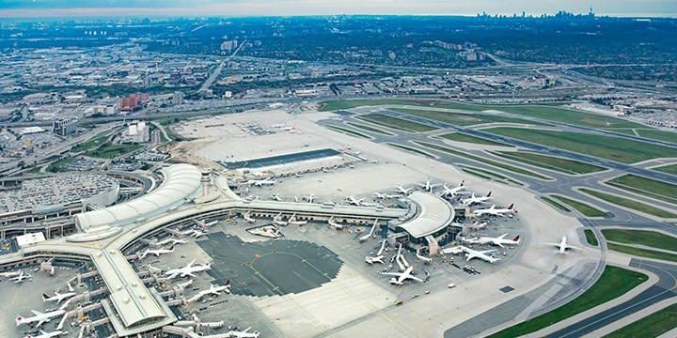


Toronto
4
Notes:
Let us use a story to demonstrate the functionalities of our map. Why not, right?
This is bob: an international student at U of T. He just got off the plane, and has absolutely no idea where everything is. Bob decided to use our super-well designed map to familiarize himself.

Slide 5

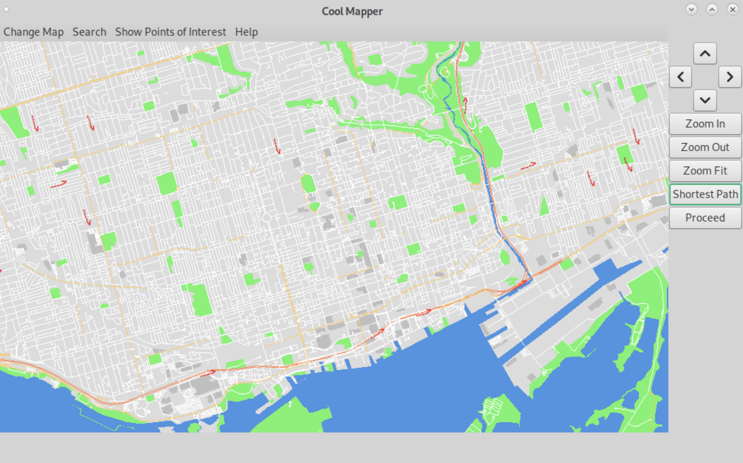
5
Notes:
6: after installing netbeans and sorting out all the files, bob opened the map.
7: The first thing that came into 主人公名字’s eyes is Toronto’s map, which occupied most of the screen.
主人公名字 is amazed by the beautiful color, and realize that more details can be obtained by zooming in, such as buildings and points of interest.
Wow, what a clever move. Said by 主人公名字
8: The menu bar is located on the top of the map. The control panel is to the right of the map.

Slide 6
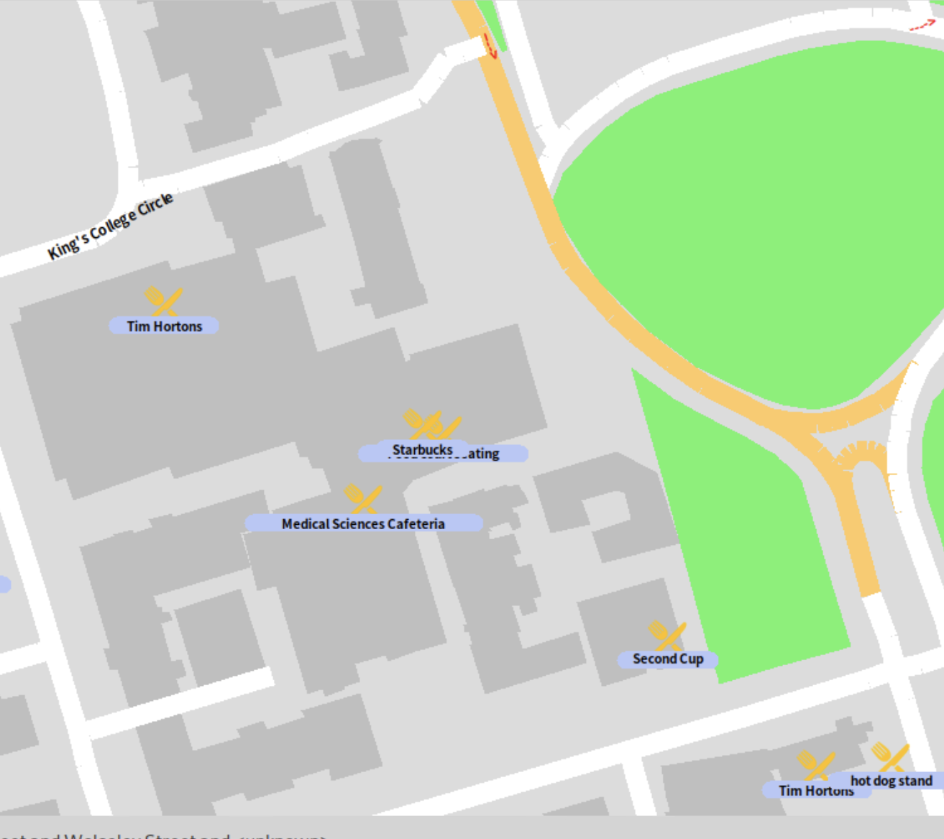
6

Slide 7
7

Slide 8

8
Notes:
The HELP page teached Bob how to use this map to search for a path.
Which is quite easy. Just tell the map which intersection you are at right now, and which intersection you want to go to.

Slide 9
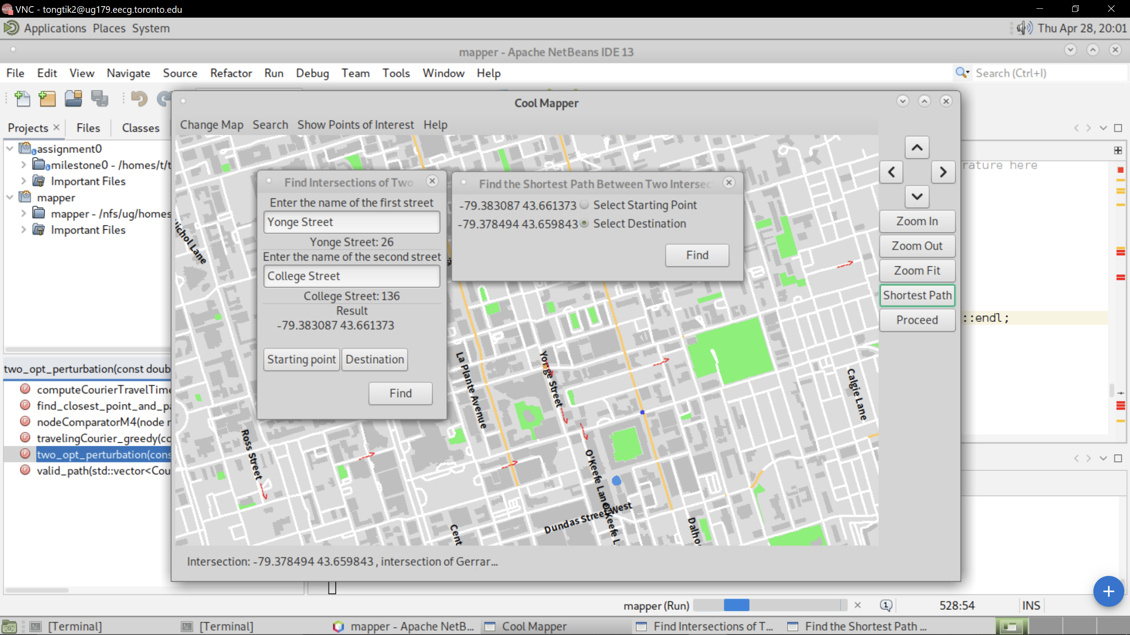
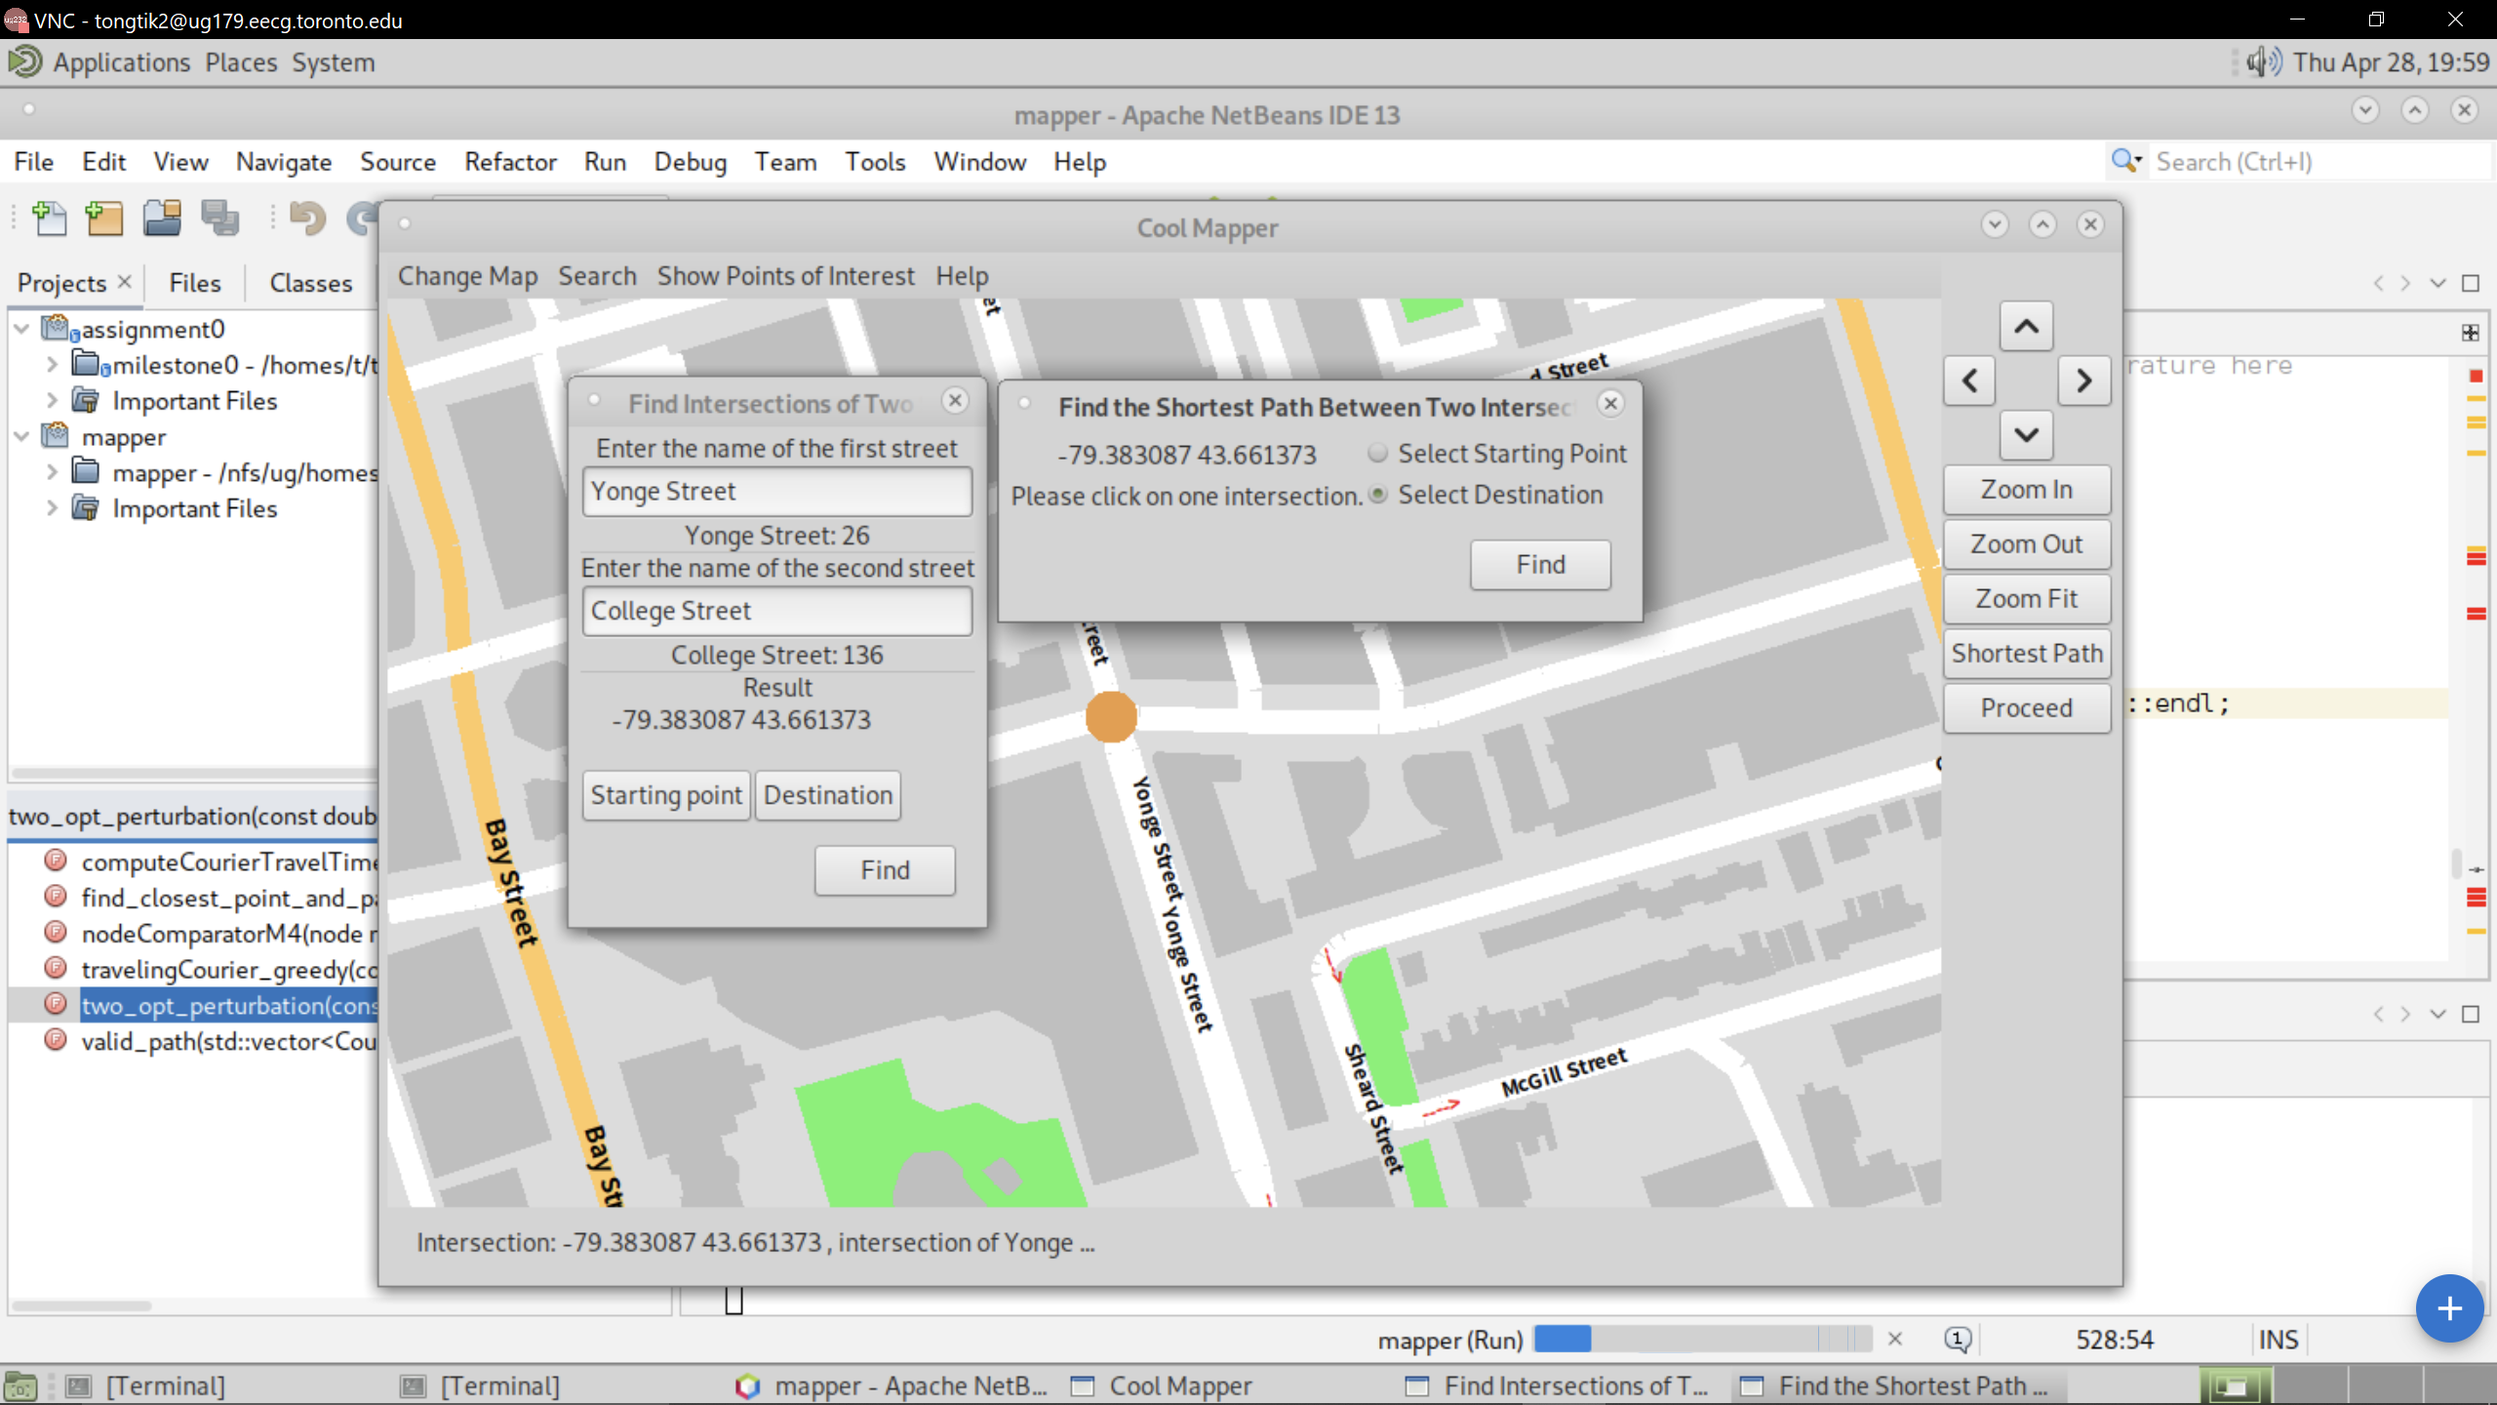

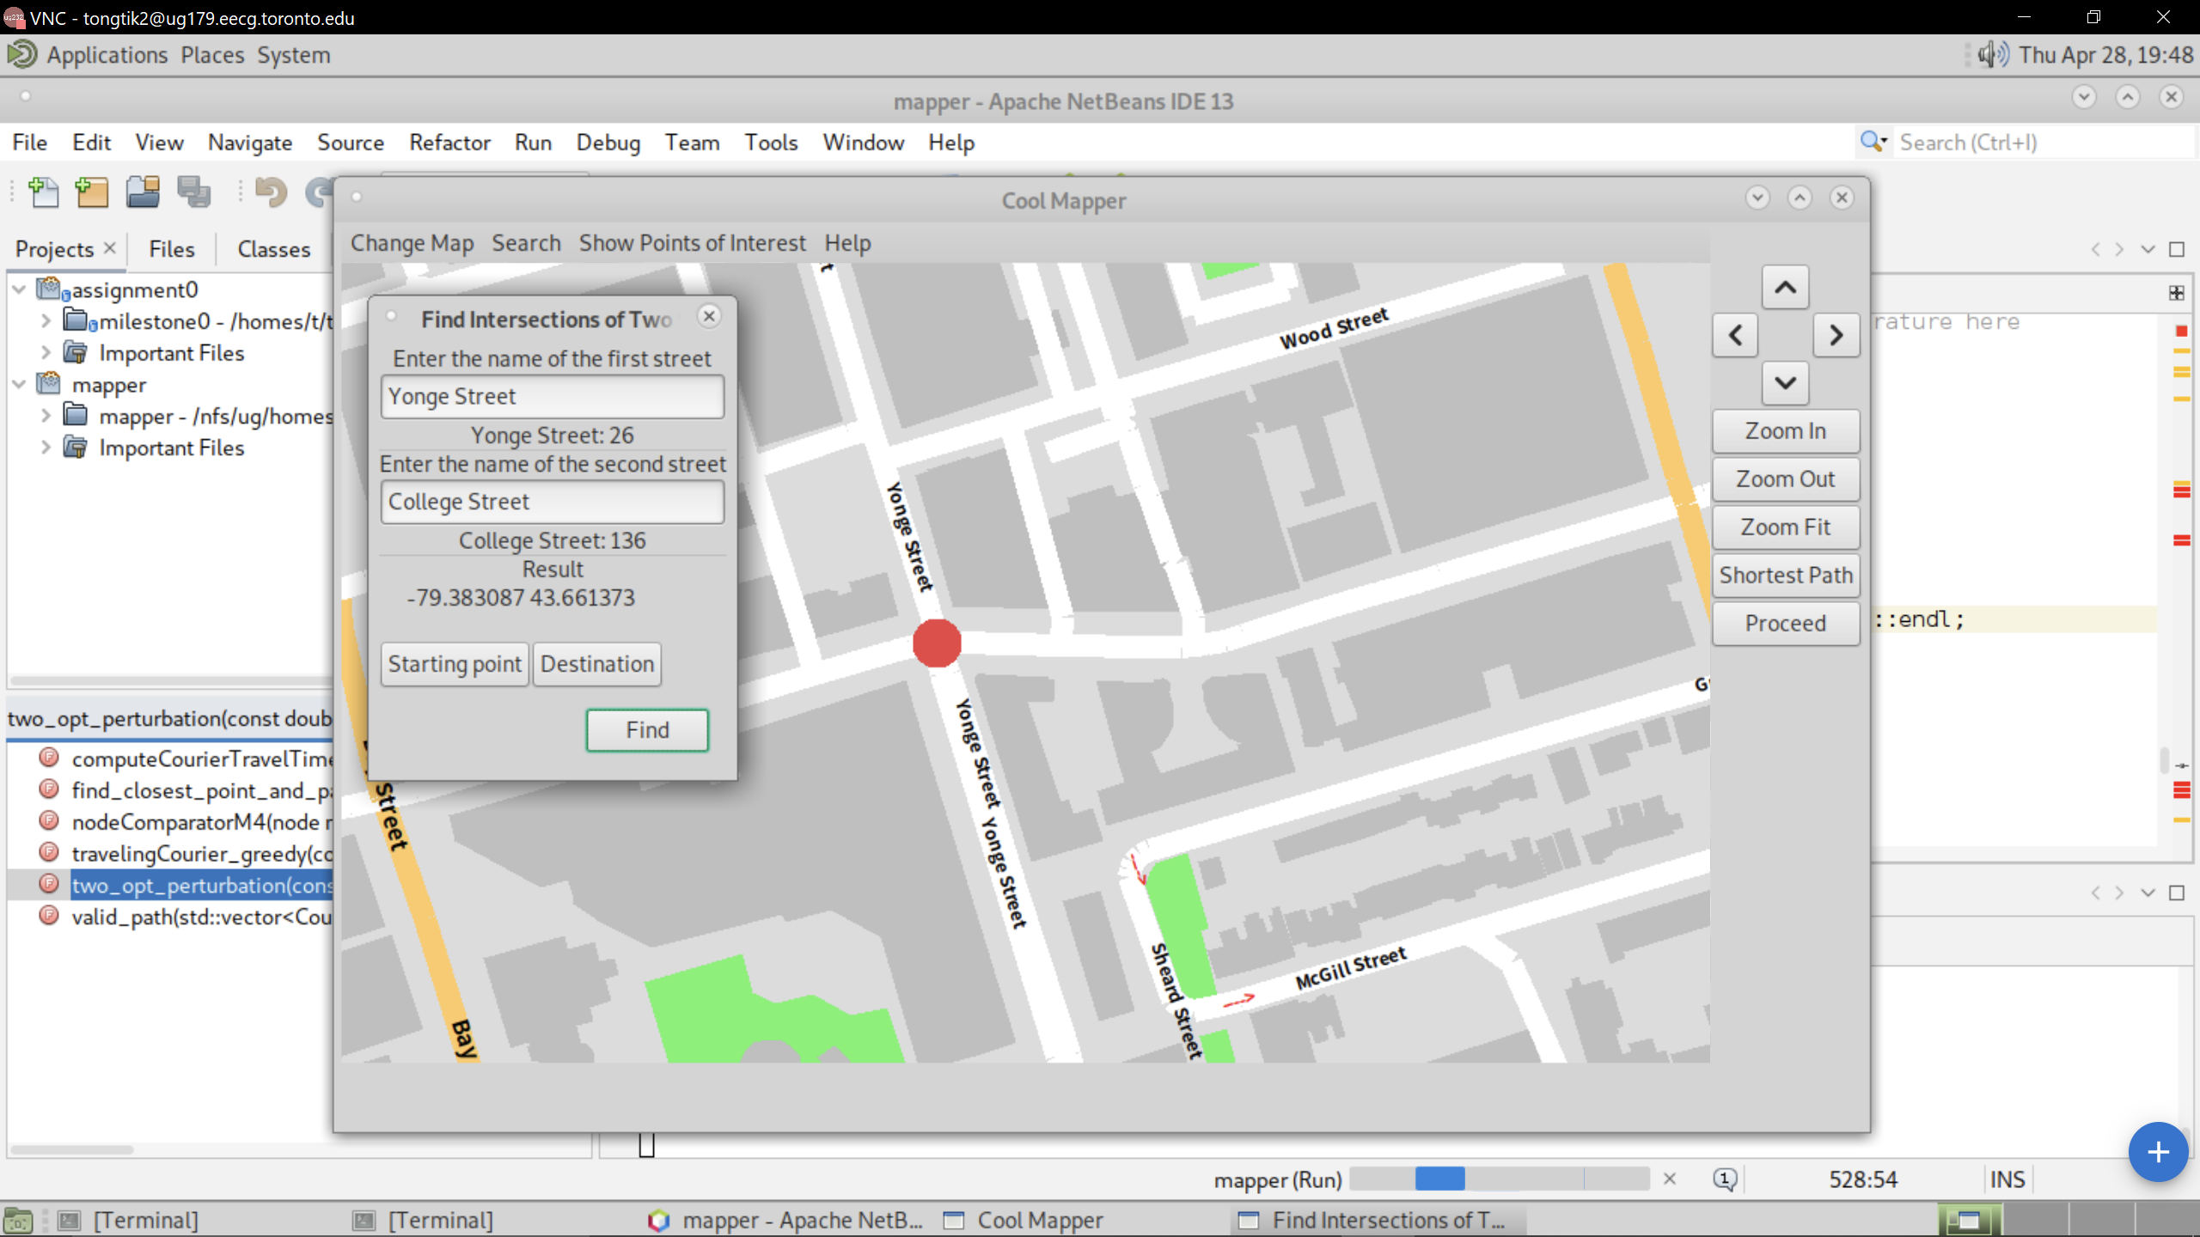
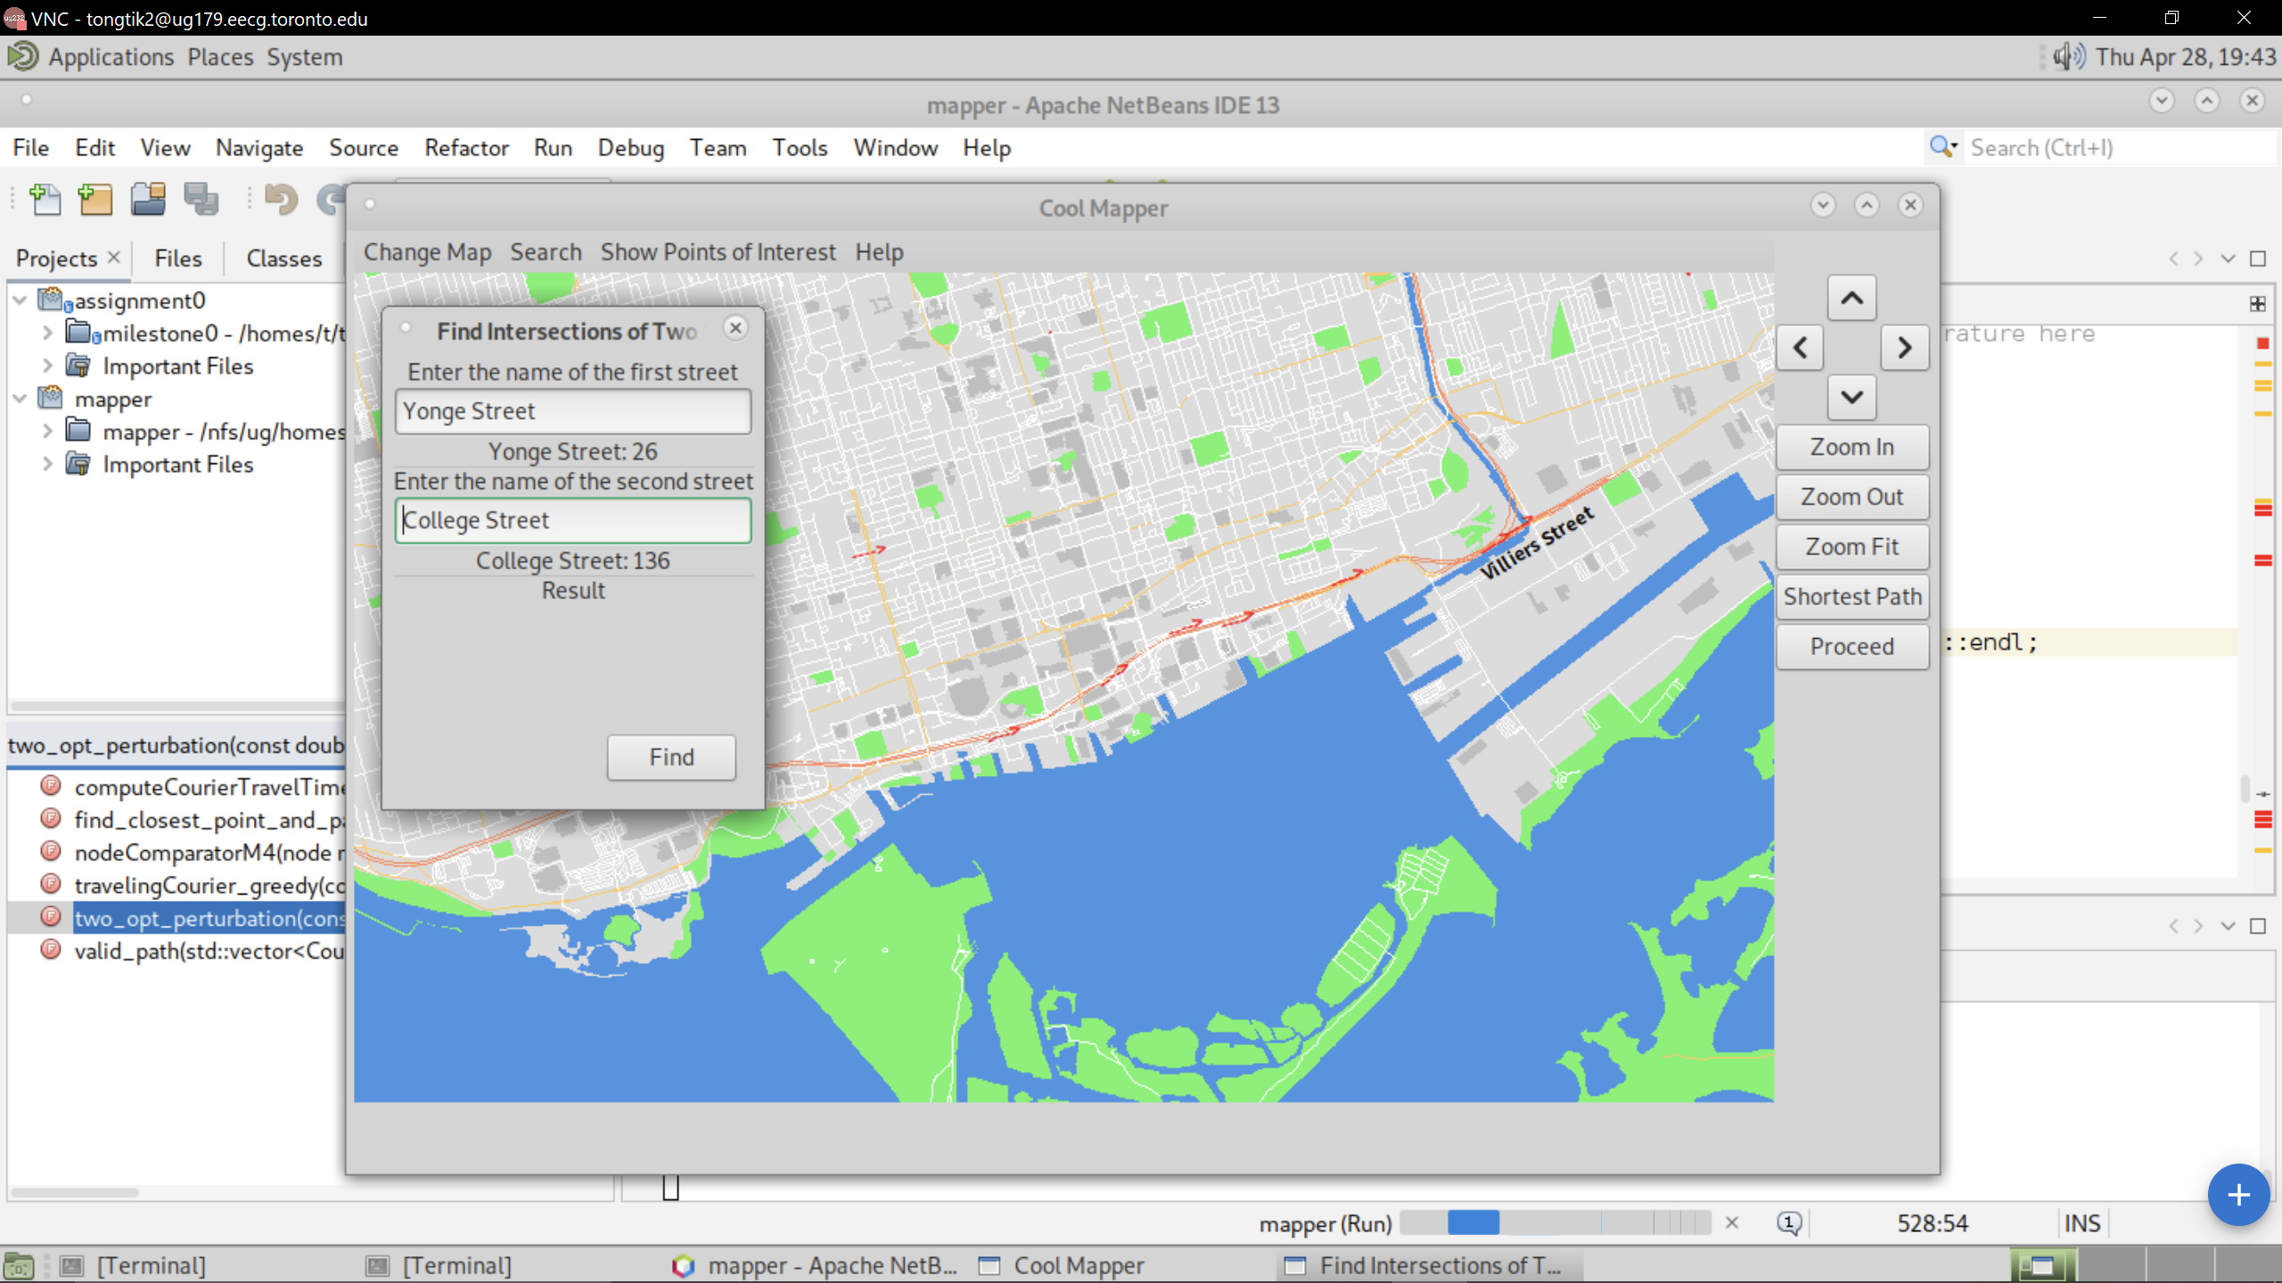
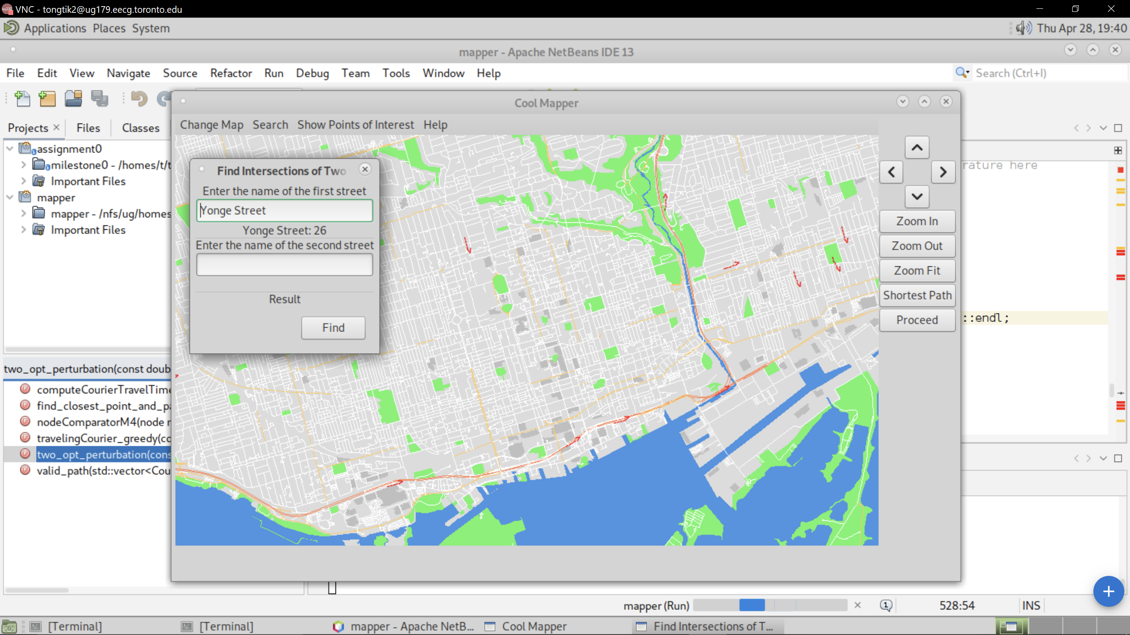
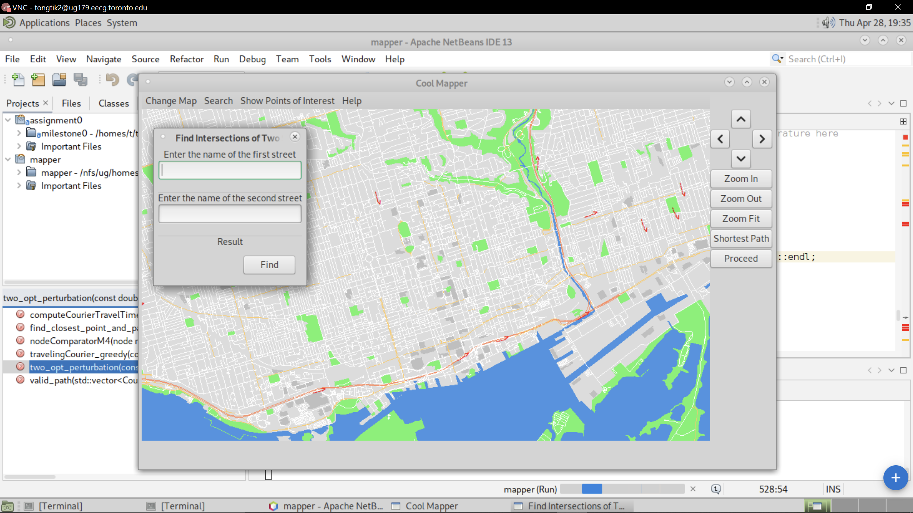
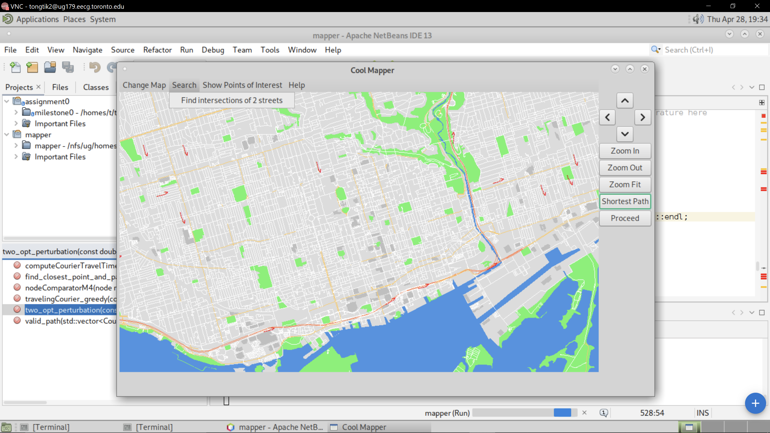
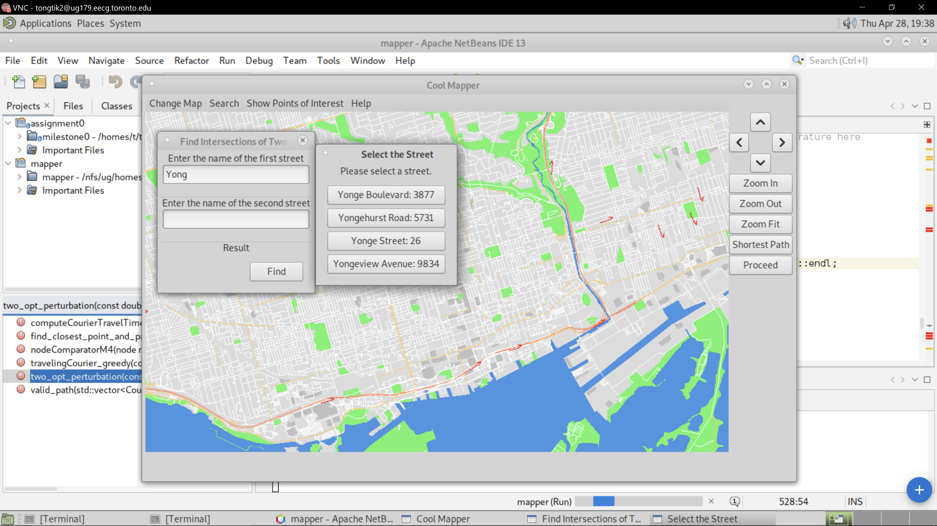

9
Notes:
It can be done in two ways. You can either clicking on the “search” button and then click on find intersection of two streets. Where you can type in the names of the two streets. Or you can just directly click on the intersection inside the map. And set it as the starting point or the destination.

Slide 10
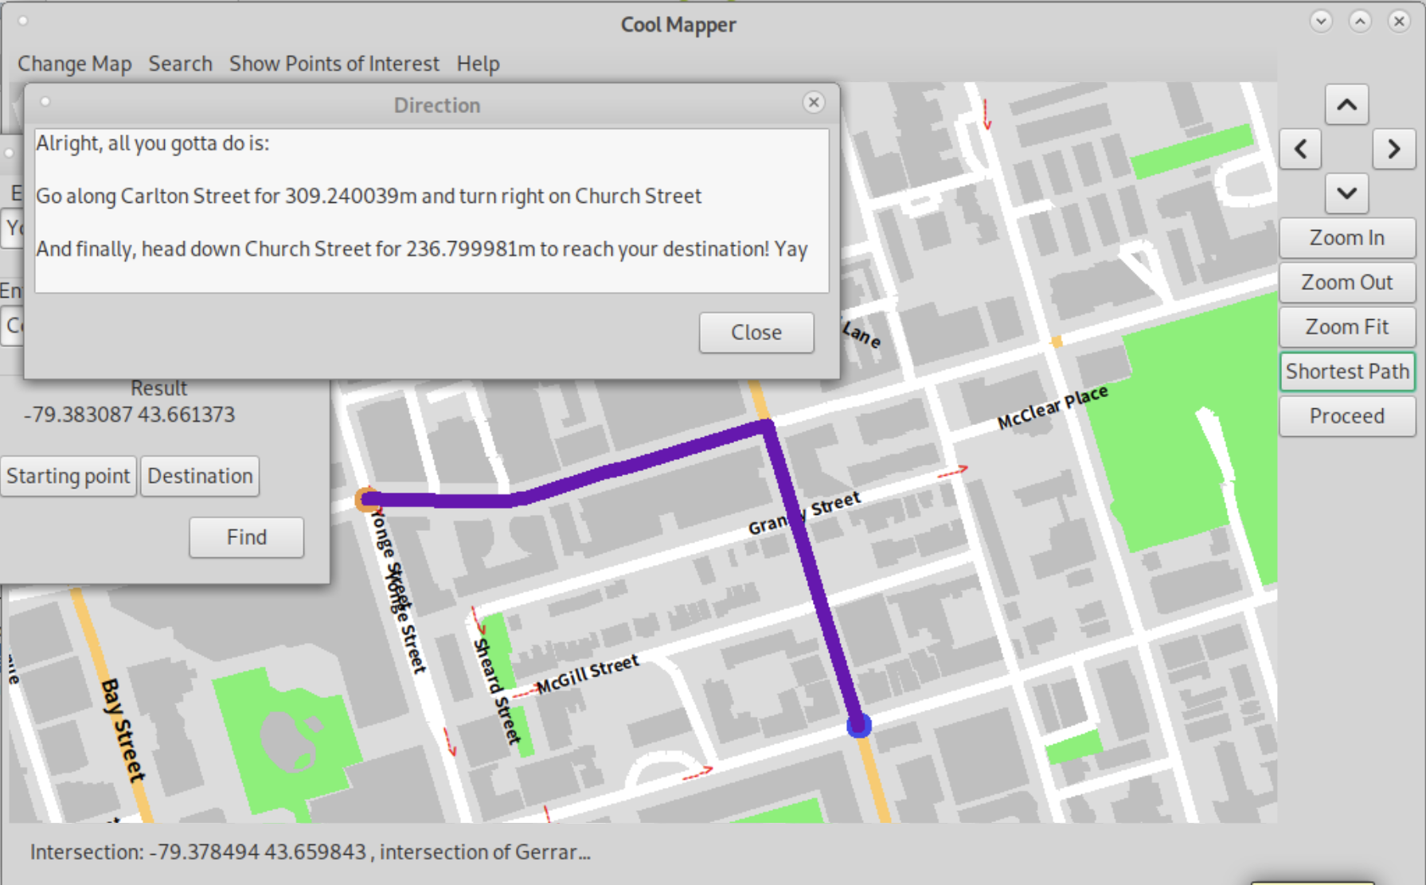
10
Notes:
This map will provide both text and visual navigation.

Slide 11
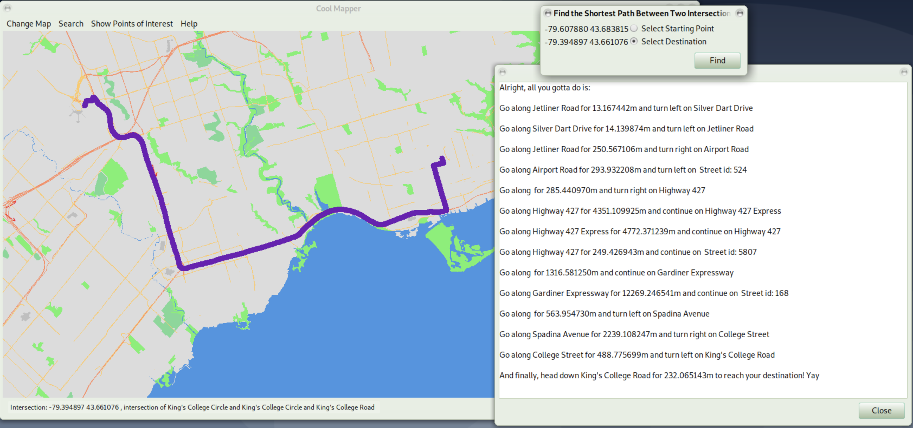
11
Notes:
Unsurprisingly, Bob follower the instructions find his way to the University of Toronto and start his new life in the university.
But know some of you might wonder how can a silly software find out the shortest path between two points this quickly, is this some kind of magic? Well, no, it’s purely science. Now please me to introduce the Dijkstra Algorithm.

Slide 12
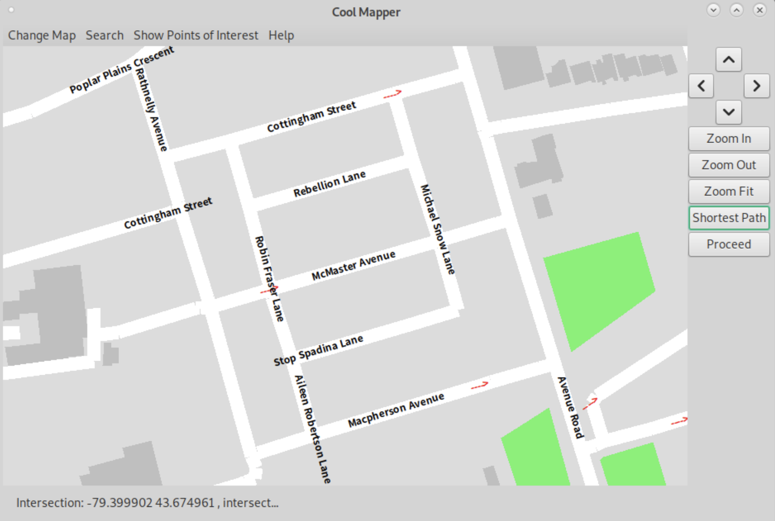
F
8
1
2
E
D
2
8
C
8
2
B
A
1
12
Notes:
This is a real example, assume all roads in this picture have the same speed limit, and now turn penalty. How would you go from the red point to the green point. Well, it’s quite easy right

Slide 13
Start Point
End Point
New Point
F
8
1
Path No.1
2
E
Path No.2
D
2
8
C
8
2
B
A
1
13

Slide 14
Start Point
End Point
New Point
F
8
1
Path No.1
1
E
Path No.2
D
2
8
C
2
2
B
A
1
14

Slide 15
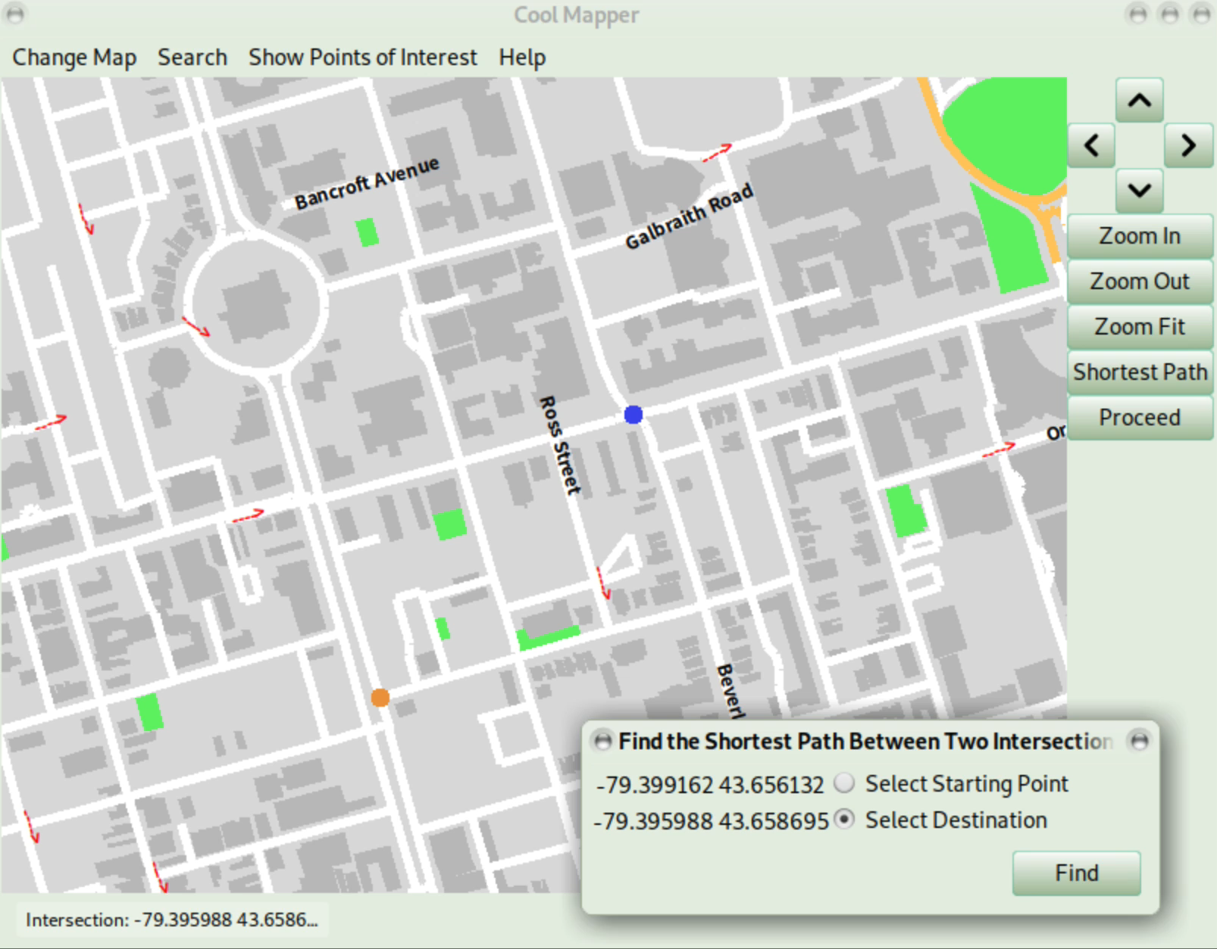
15

Slide 16
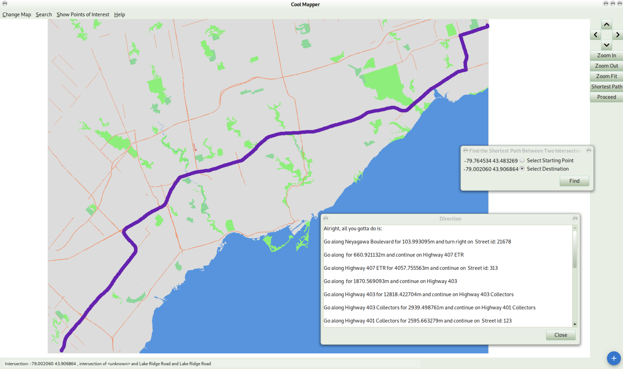
Performance of Dijkstra’s Algorithm
Left bottom corner to right top corner of the city: 0.088s
16

Slide 17
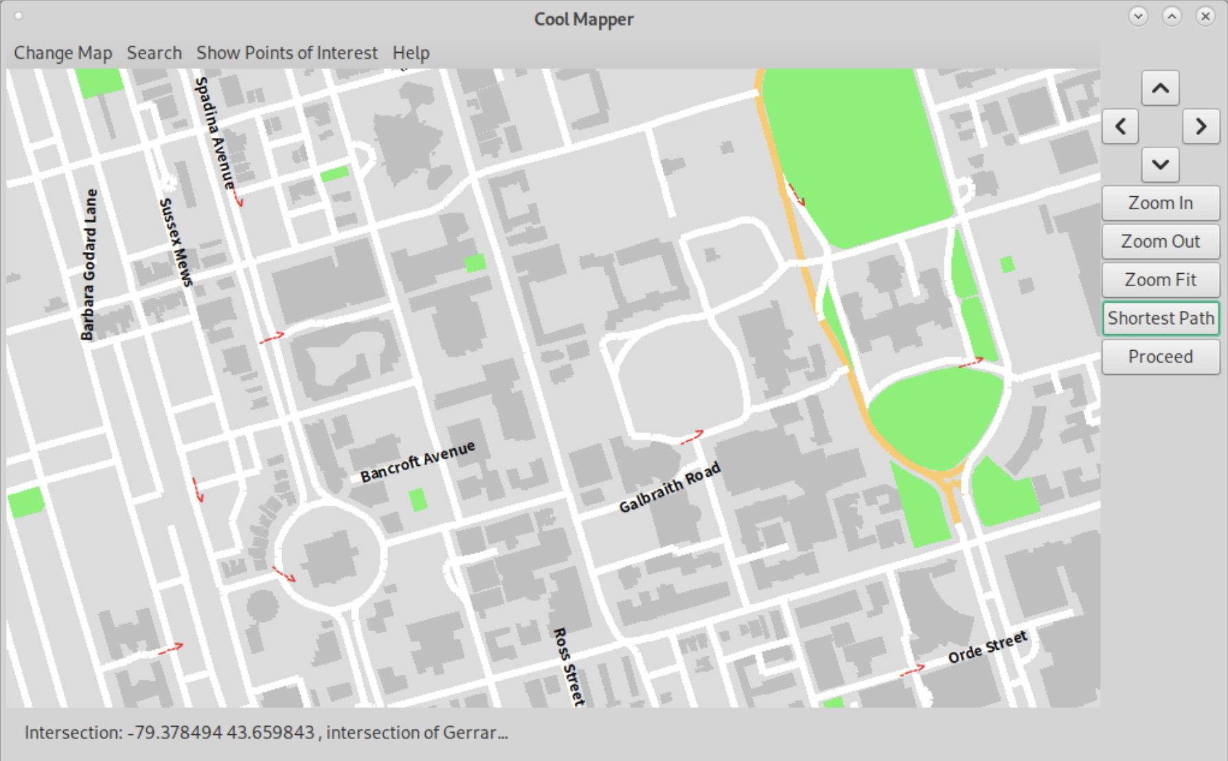
Scavenger hunt game in !Frosh
END
3
1
2
2
1
3
Start
17
Notes:
Skule^TM Scavenger hunt:
Pick up all items at red point and drop off at blue point. Start and end are fixed.
One pick up point matches a drop off point.
Intend the find the shortest path to pick up and drop off all items.

Slide 18
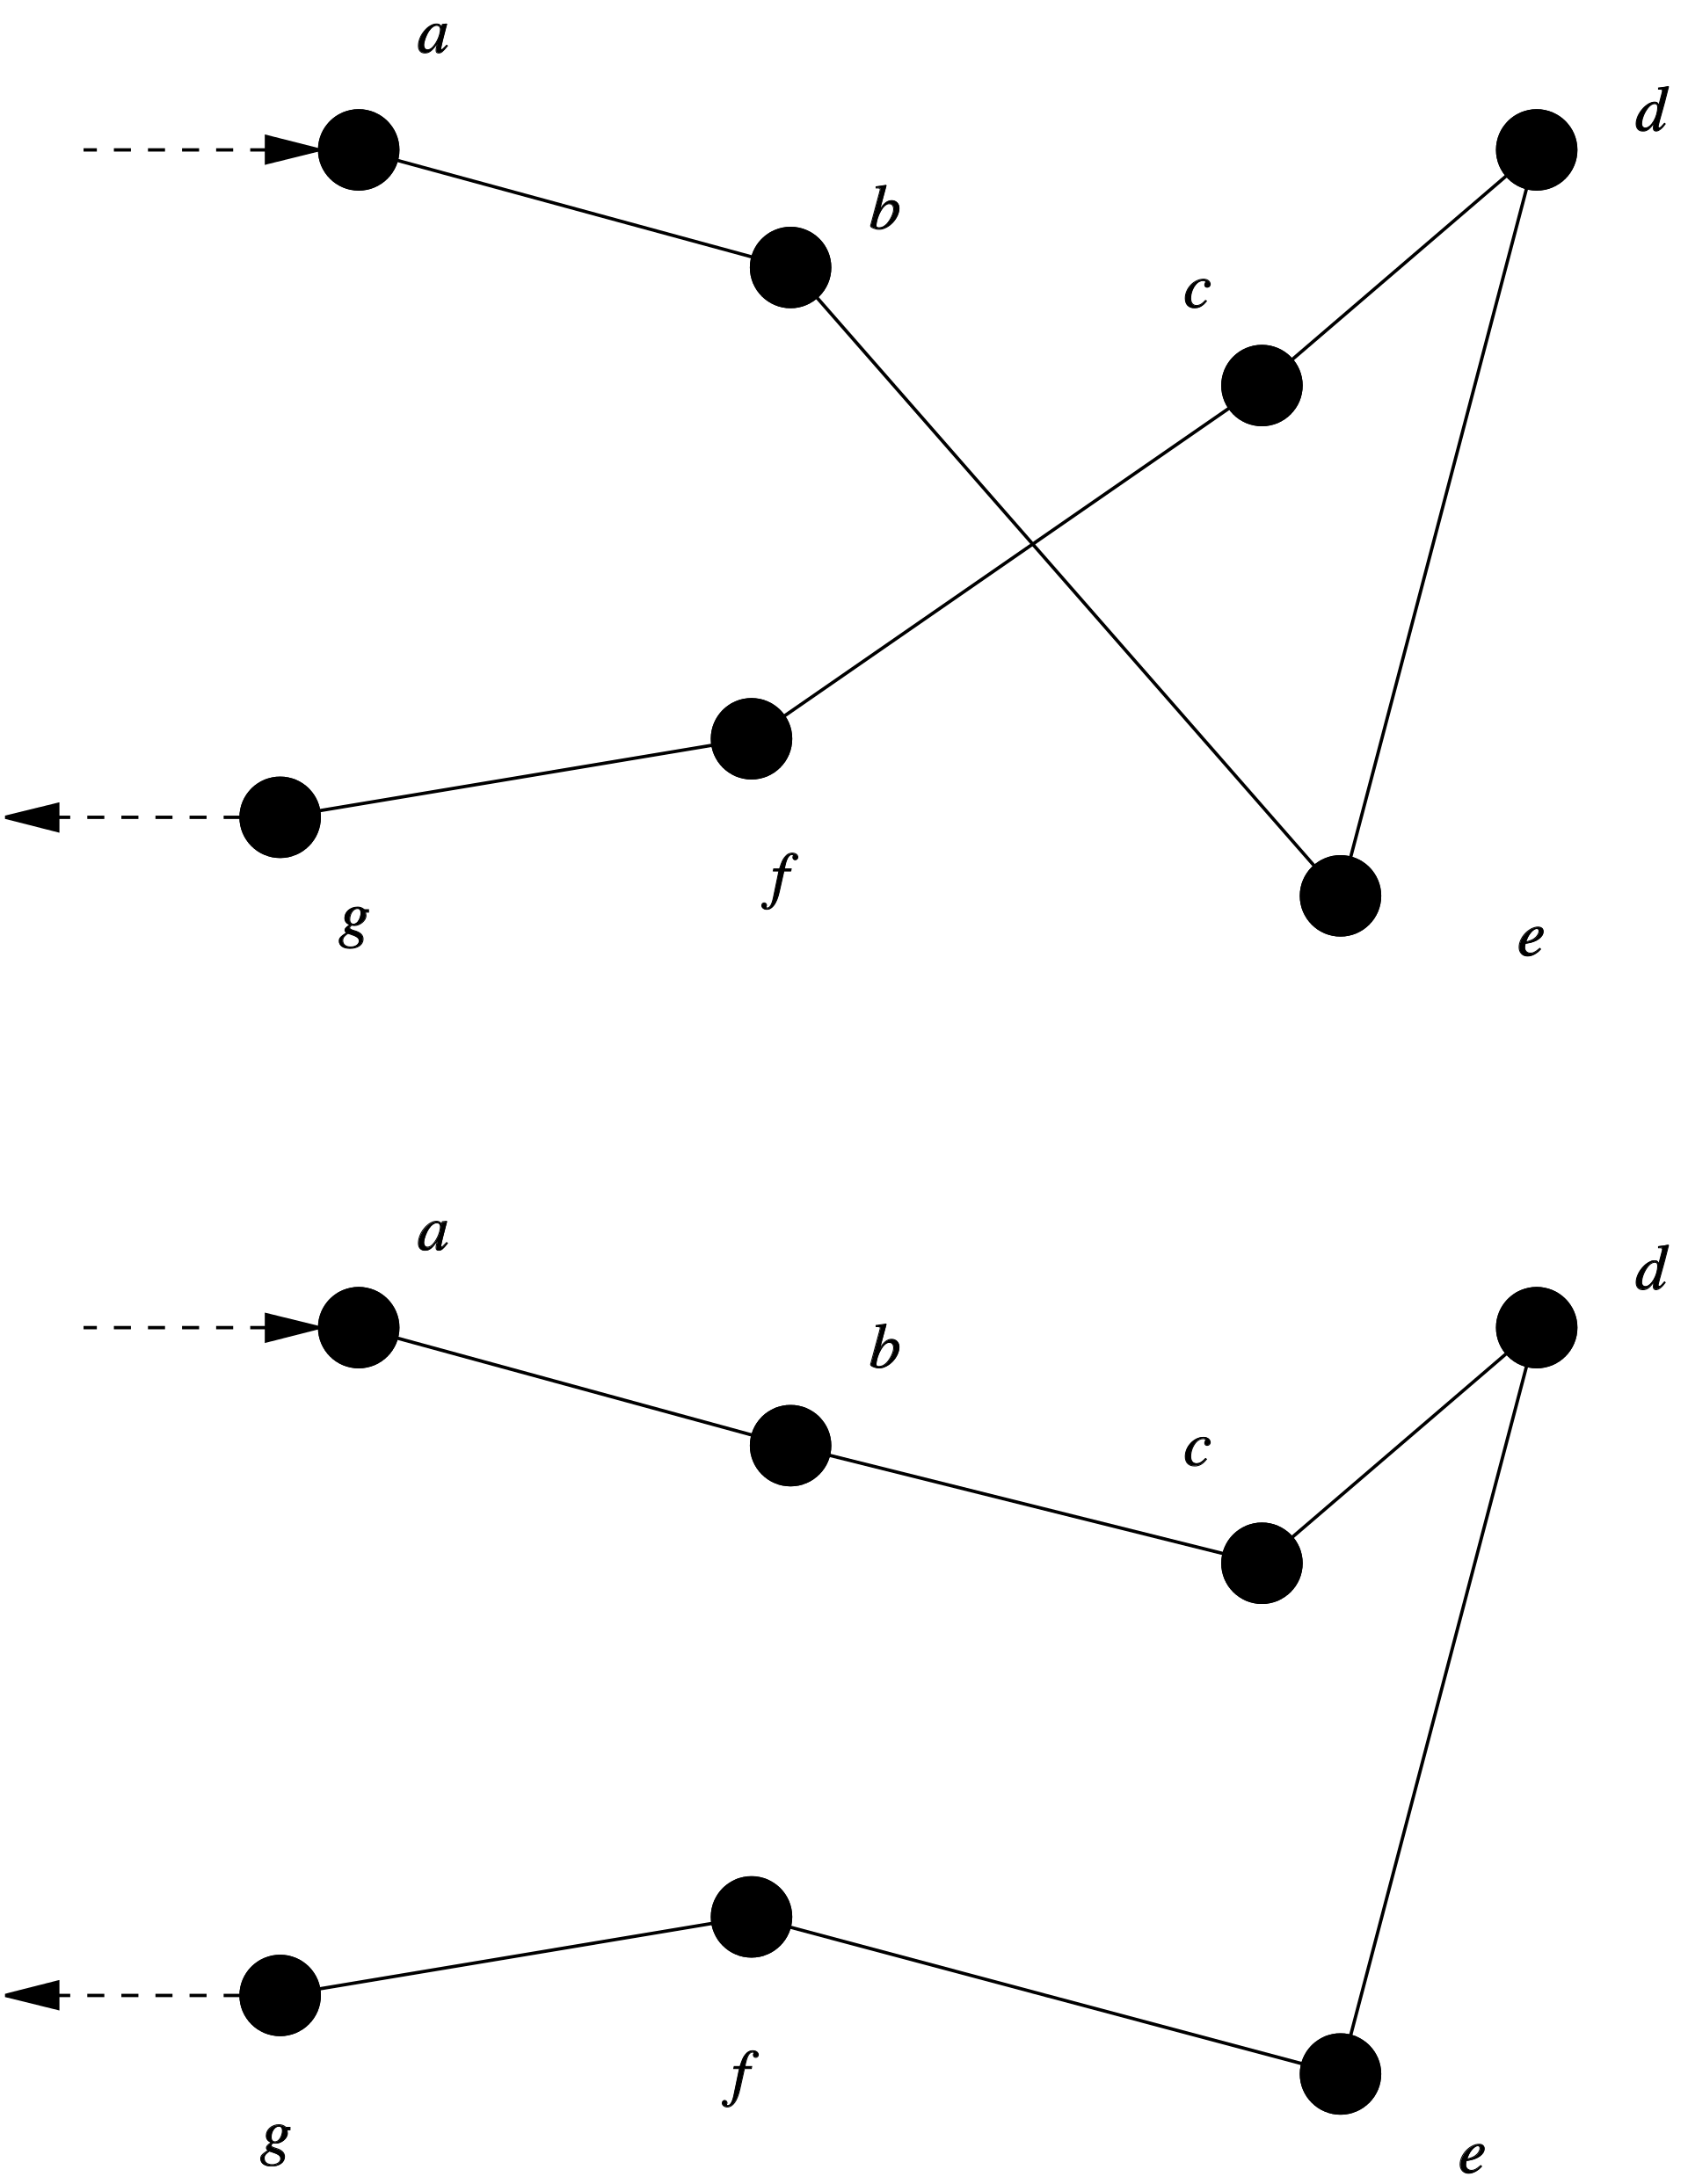
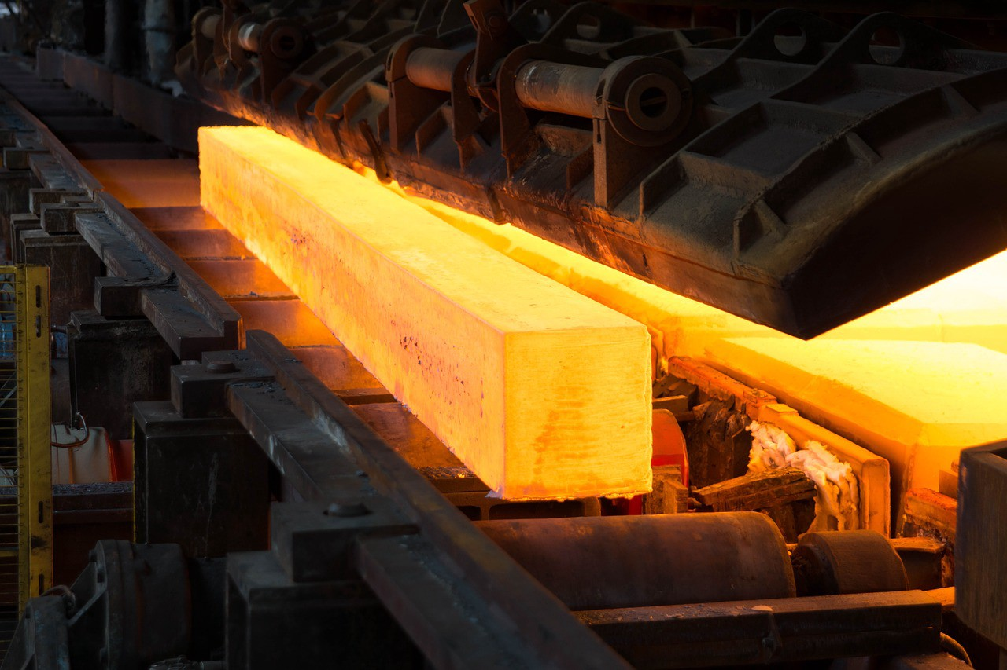
Algorithm of Courier Problem
Dijkstra’s Algorithm with multiple destinations
Simulated annealing
2-opt
Consider a new solution that might be worse currently
Traverse and the closest valid point
Exchange two subpaths and find whether the new solution is valid and better
First solution
Improve the first solution
We cannot find the best solution.
We can only increase the probability of finding a better solution.
18
Notes:
Here is an algorithm for scavenger hunt, which is also known as courier problem in M4. The whole algorithm could be divided into 3 parts: Dijkstra’s Algorithm with multiple destinations, 2-opt, and simulated annealing. Dijkstra’s Algorithm can be used to find the first valid solution. 2-opt and simulated annealing are used to iteratively improve the first solution.

Slide 19
Update the list
Destination list: 1, 2, 3
Destination list: 1, 2, 3
Destination list: none
Dijkstra’s algorithm with multiple destinations
END
Greedy Algorithm: only looks for the current best solution
Not the best solution, but better than picking up and dropping off in random order.
3
2
1
2
1
3
Start
Pick up point #2
Note: red points represent pick up points, and blue points represent drop off points.
19
Notes:
We can get our first solution using Dijkstra’s Algorithm, which is the algorithm we previously talk about.
First put all pick up points in our destination list.
Starting from the Start point, we can use D to search for the closest point in the destination list, which is pick up point 2. Drop off point 1 is not considered because package number 1 hasn’t been picked up. Then we remove the pickup point 2 and put drop off point 2 in the list. Iteratively, we can get the first solution.

Slide 20
2-opt
d
a
c
Exchange 2 subpaths and find whether the new solution is better
b
e
f
20
Notes:
Our first solution is not the best, so we can improve it using 2-opt algorithm, which exchanges 2 paths in the solution, and then find out whether the new solution is better. Those 2 paths should neither be neighbours, which means that you cannot select bc and cd, nor should be too far away from each other, because it is not likely to make improvement if 2 paths are far away.
Here is an example, I want to exchange bc and de, so first remove them. Then, we connect b with d, c with e. cd should also be reversed to dc. Then , we check whether this solution is valid and better.

Slide 21
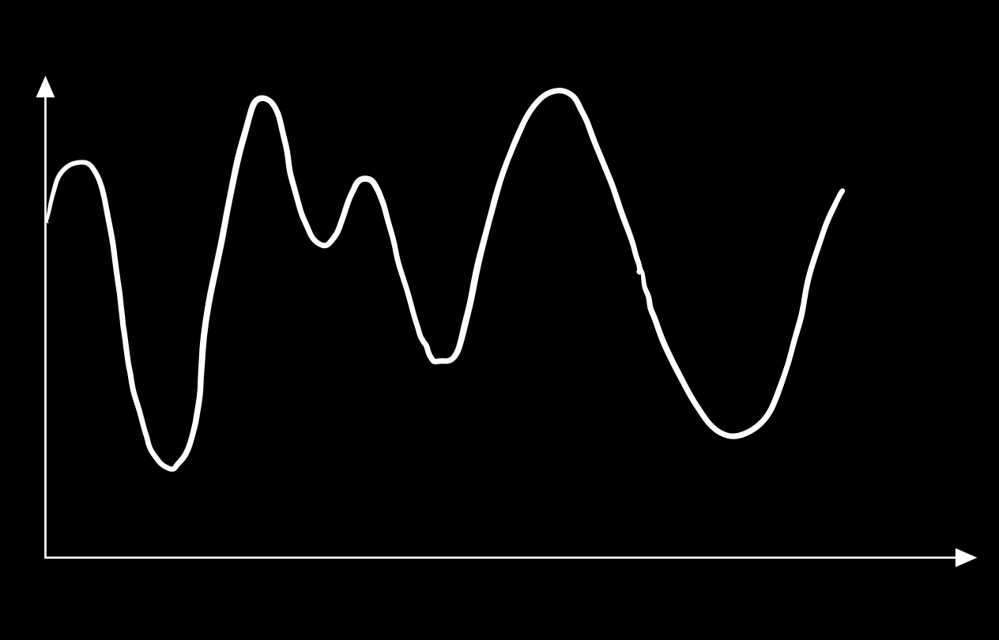
Simulated annealing
Climbing a hill: finding the lowest point in the mountain.
Consider a worse solution after a 2-opt perturbation, because it may lead to a better solution.
If we climb up a little bit
First solution from Multiple Dijkstra
Time
Note:
Probability of climbing up a hill depends on temperature.
Temperature decreases with the simulated annealing process. (Similar to real annealing process)
2-opt perturbation
If we only climb down, we can only find the lowest point locally.
We can get a better solution
Solution
21
Notes:
Simulated annealing method could improve our 2-opt perturbation. It is similar to climbing a hill, but you want to find the lowest point in the mountain. Using multiple Dijkstra, we find the first solution. Two-opt local perturbation is just like climbing a hill up and down. If we only consider better solutions, just like climbing down the hill, we could go to the minimum point locally, but this is not the lowest point in mountain. If we climb the hill up a little bit, in this case we can get a better solution.
Therefore, simulated annealing consider some worse solutions, because it may lead to some better solutions afterwards. Also, of course we don’t always climb up the hill. There is a probability. This probability depends on a number called temperature, which decreases with time.

Slide 22
Quality of Result (QoR Score)
Less is better
Note: this QoR score is calculated from the average of hard and extreme test cases in M4 public test.
22
Notes:
I’ll show you how 2-opt and simulated annealing could help to improve the solution. For QoR score, less is better.
From this graph, we can see that 2-opt can improve the first solution significantly. Incorporating simulated annealing in 2-opt perturbation can slightly improve the solution.

Slide 23


23
Notes:
In a blink of an eye summer is here! Bob decided to travel to Bejing for vacation, and to breath in some of that sweet sweet smog. Luckily, our mapper got him covered!

Slide 24
24
Notes:
As bob cliked on the change map button and selected his city, he is greeted by the map of Beijing in about 30s.

Slide 25
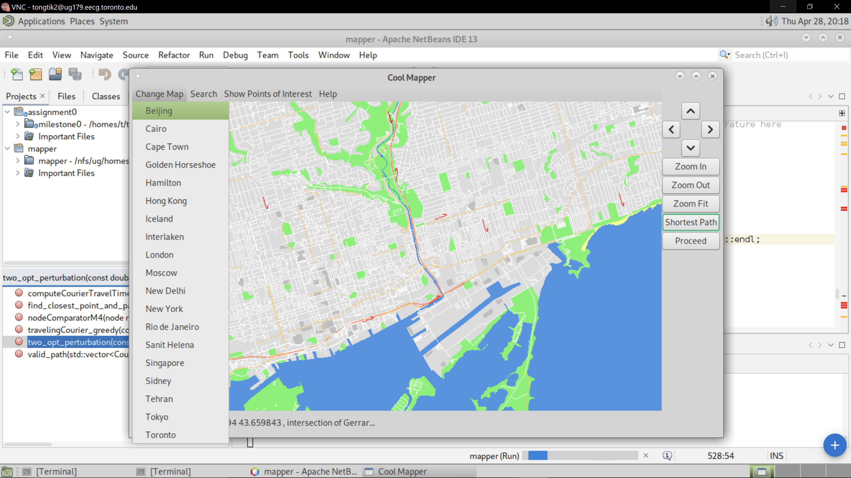
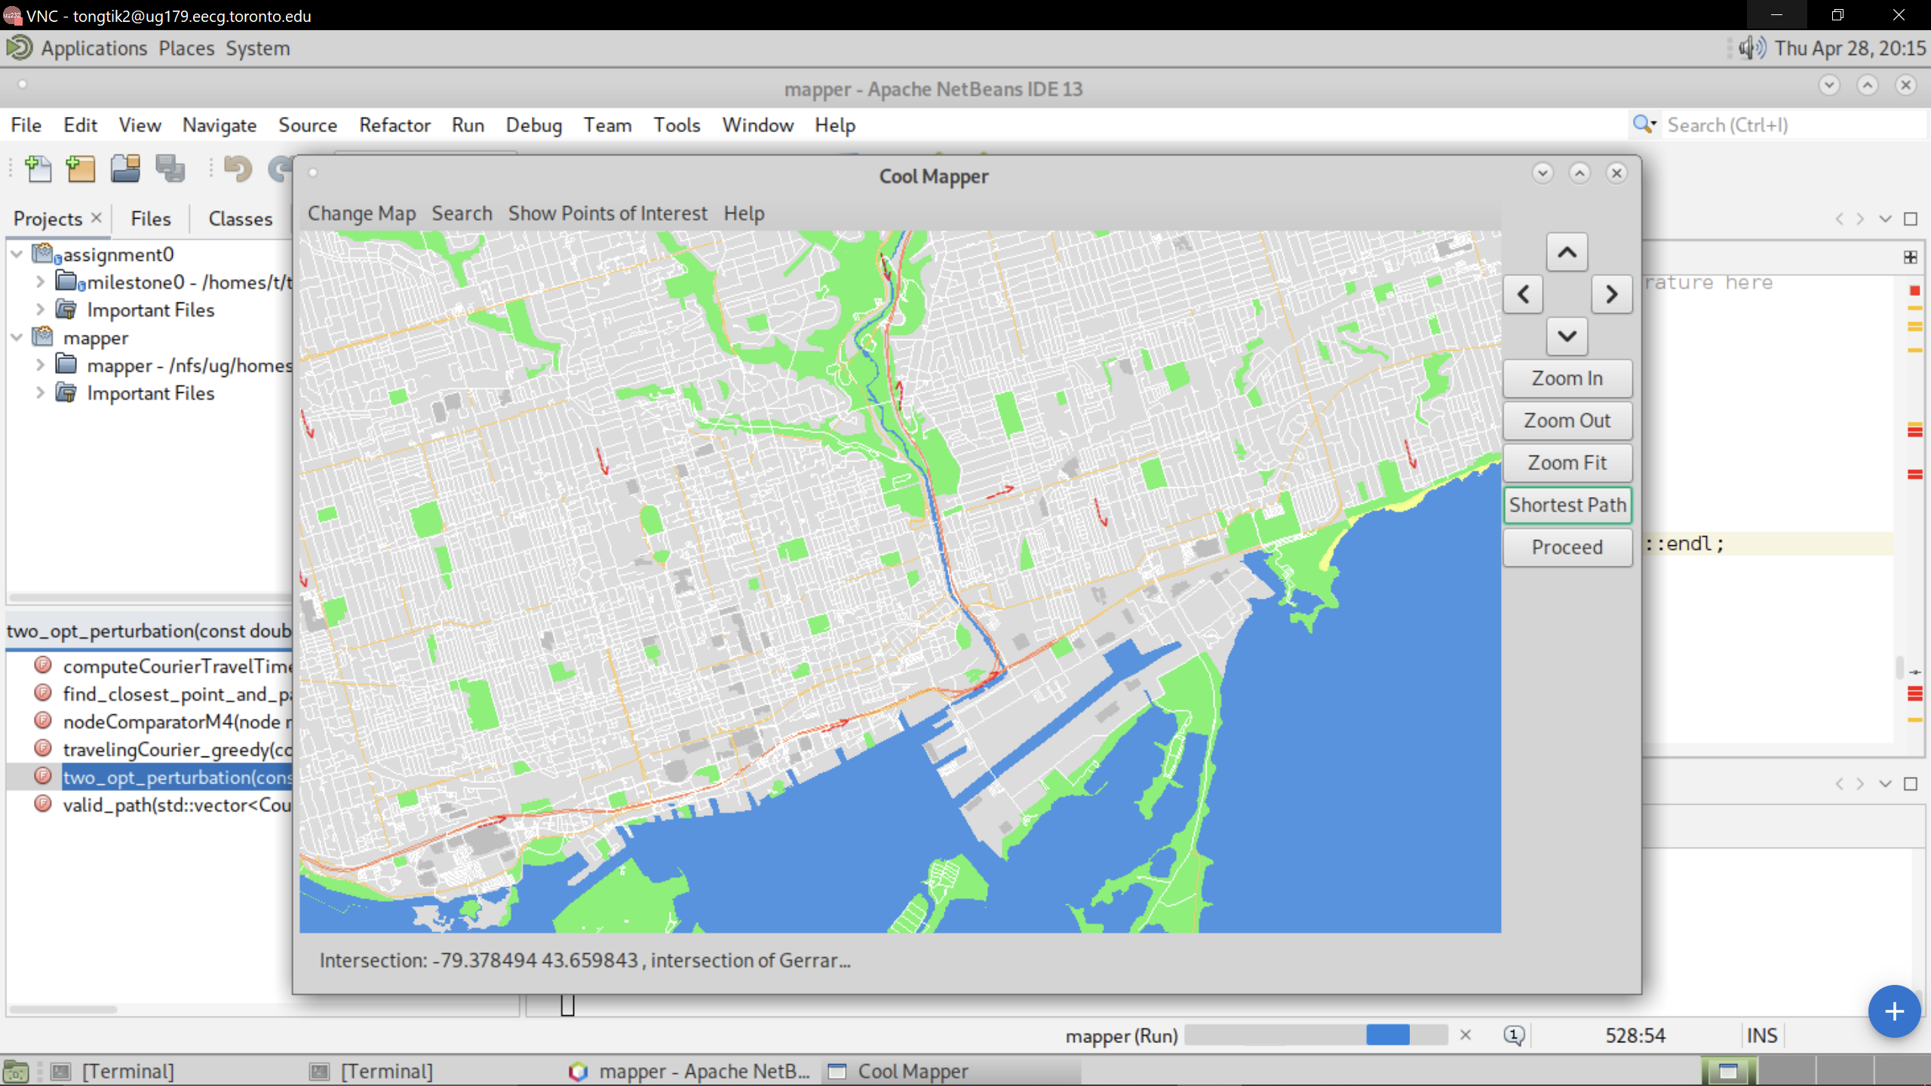
25

Slide 26
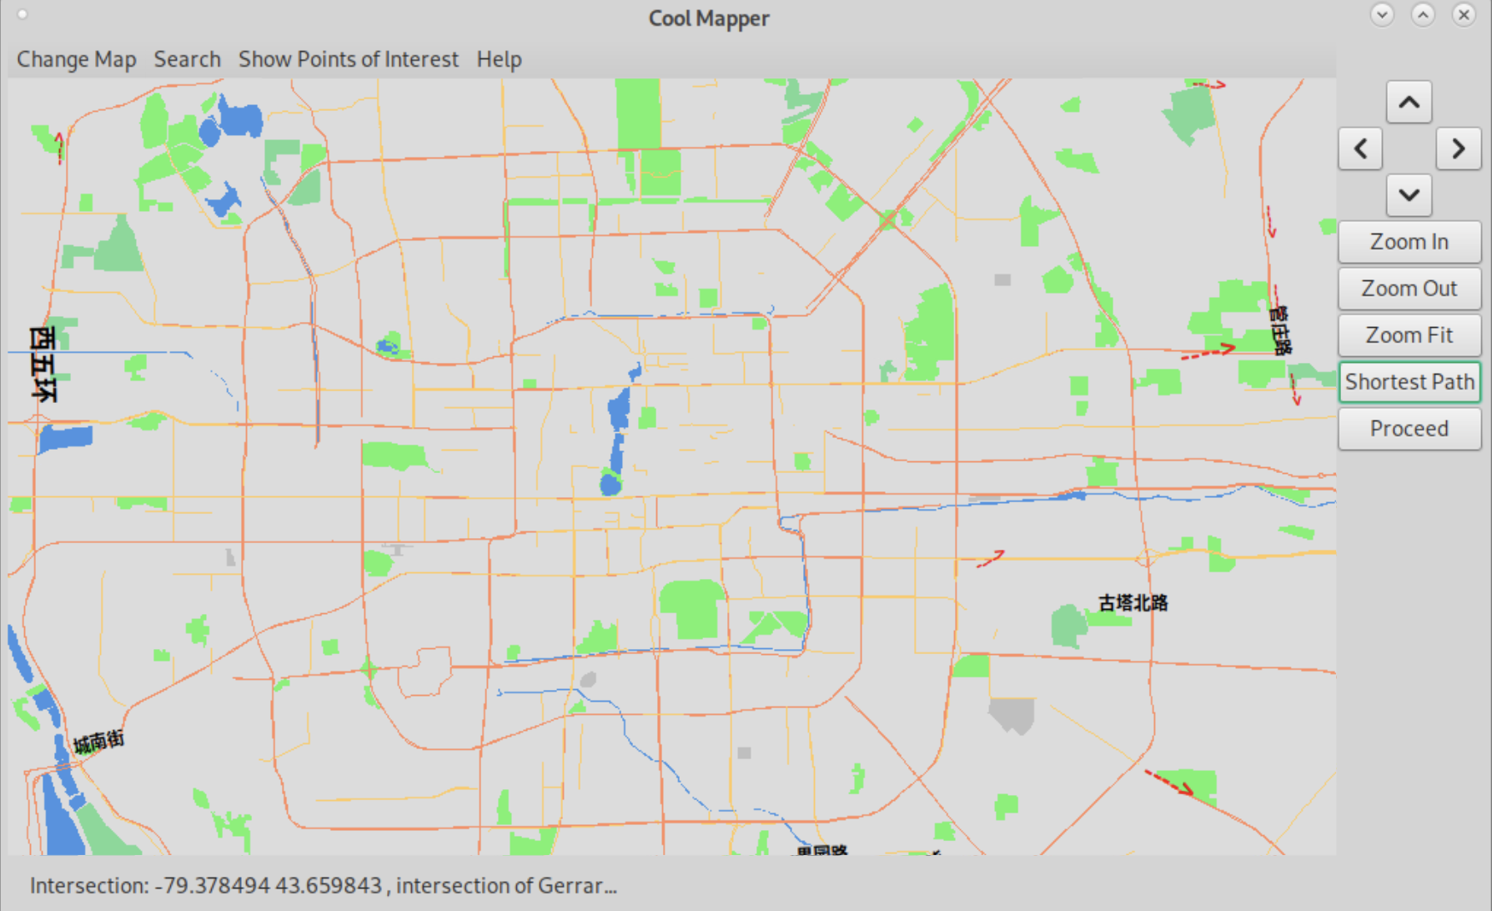
26

Slide 27
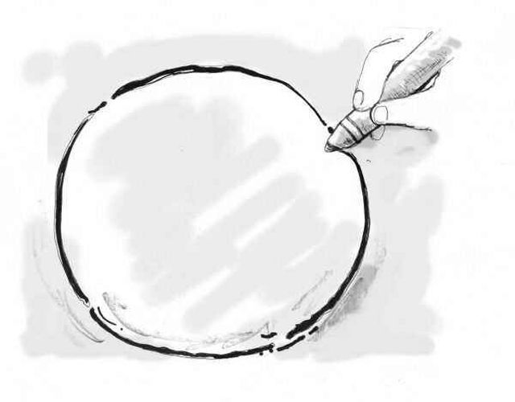
The Pitch
27
Notes:
Story time is over. Was it good? Now I will pitch you our idea to improve our map.

Slide 28

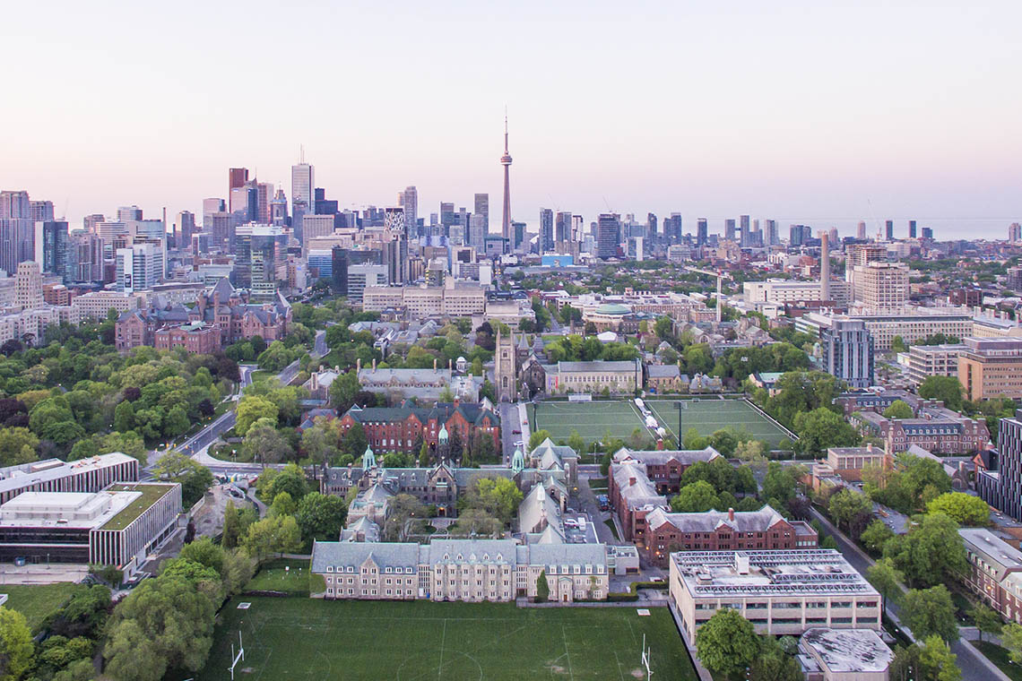
THE GAP - Lack of mapping programs tailored for students!
28
Notes:
From our work in this project, we realized that there is unexploited potential in mapping programs for students.
While popular solutions such as google and apple maps are generally usable for everyday navigation, there is not a specific map for students, who often needs more than the basic functionalities.
U of T is not a small school, and navigating it is a pain. Not only do students have to memorize the location of the buildings and navigate through confusing corridors with unhelpful signs, but also have to deal with irregular timed and located lectures, lab sessions, and exams.
Wouldn't it be nice to have an program to deal with it all?

Slide 29
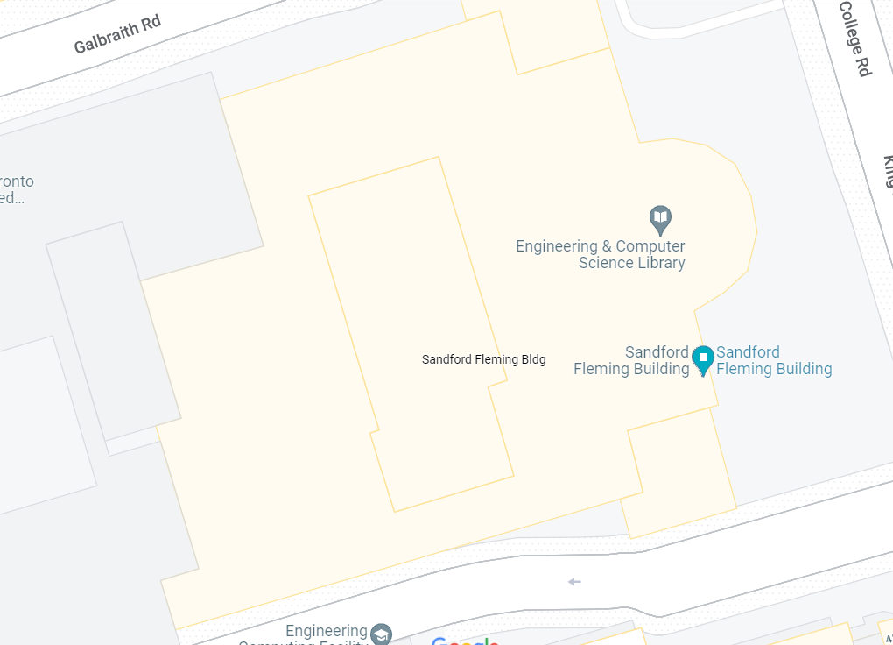
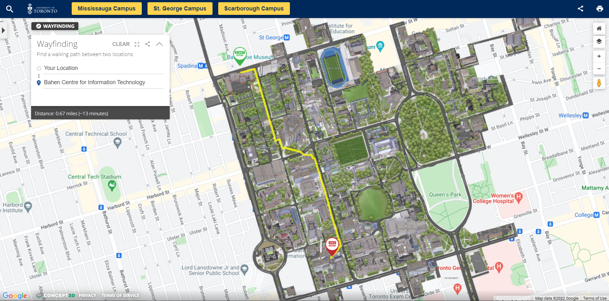






Integration with school life
Work with U of T student accounts
Allow input from professors and TAs
Room-Specific location data for school buildings
29
Notes:
Imagine this: instead of fumbling with the acorn time table and whatever mapping solution that U of T offers, an application will show you where you need to be?
To achieve this, our mapper program will use students u of t account to pull individual time table from the Acorn database. There will also be an web based interface for professors and TAs to post unscheduled meetings such as office hours and exam times to their respective student sections.
Moreover, the map will include room-specific location data for school buildings. I have lost myself on the third floor of medical science building every time I went there. Instead on relying on the ambiguously worded signs, our application could display the exact path to the classroom, in addition to nearby water fountains and bathrooms.

Slide 30

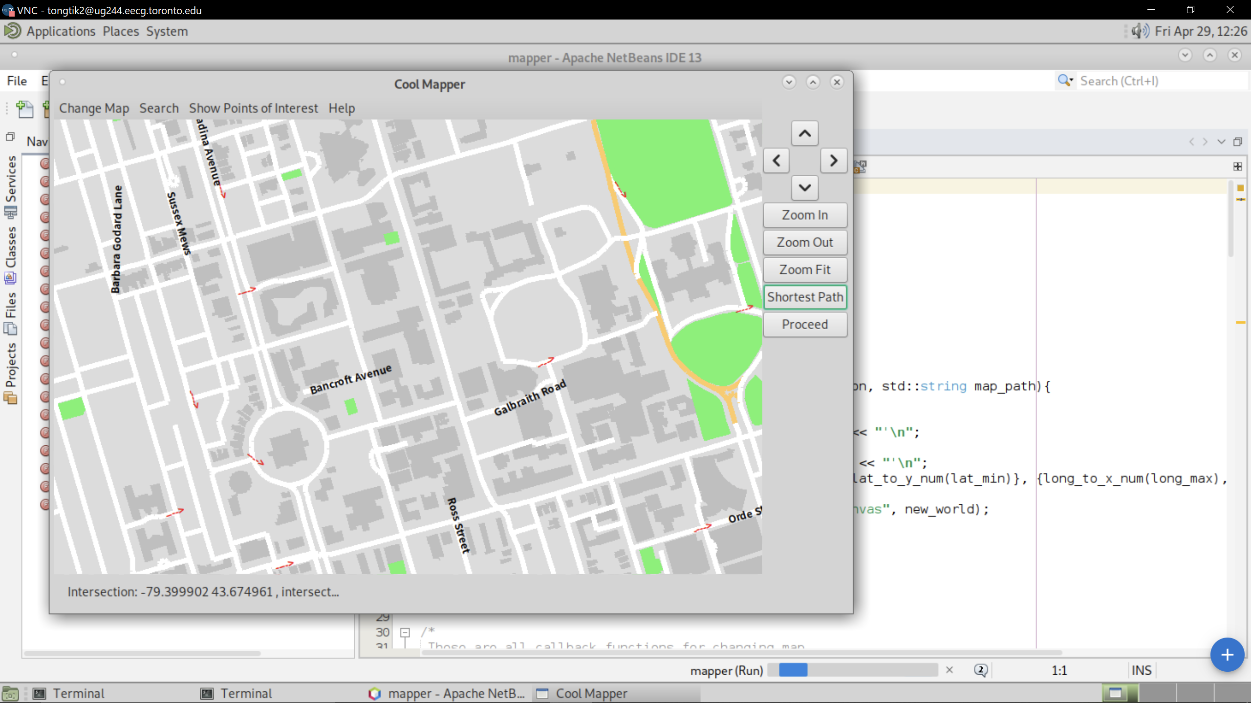
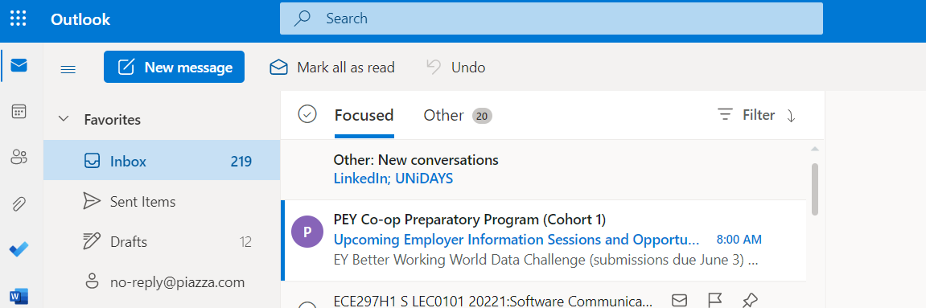







The Hub
30
Notes:
A specialized mapping application can also come in handy for extracurricular activities. As society slowly frees itself from the evil grasp of Covid, we also need to welcome back the "rich" night life that is fit of an U of T engineering student. However, currently the only way to notify the student body is through email, and to be honest, the last thing I want at the end of the day is to look through my mailbox.
We think that our map can be adapted into a social hub of sorts, and have upcoming activities shown directly on their locations on the map. This is a much more accessible and inviting way to inform people about what's going on, and hopefully will enrich my lackluster social life.

Slide 31



More Features and Platforms
Display current location using GPS
More advanced search bar
Smooth zooming
More information about points of interest
31
Notes:
To make our program more usable, we also need to add some basic features, which includes displaying current location using GPS data, a search bar that works with more than street names, a zooming feature that doesn't do it in chunks, and showing more information about points of interests.
Of course, our program will never take off on linux, an OS that no one uses. To make our program more accessible to our targeted users, we will adapt our mapper application to more popular systems, that is IOS, android, windows and macOS.

Slide 32

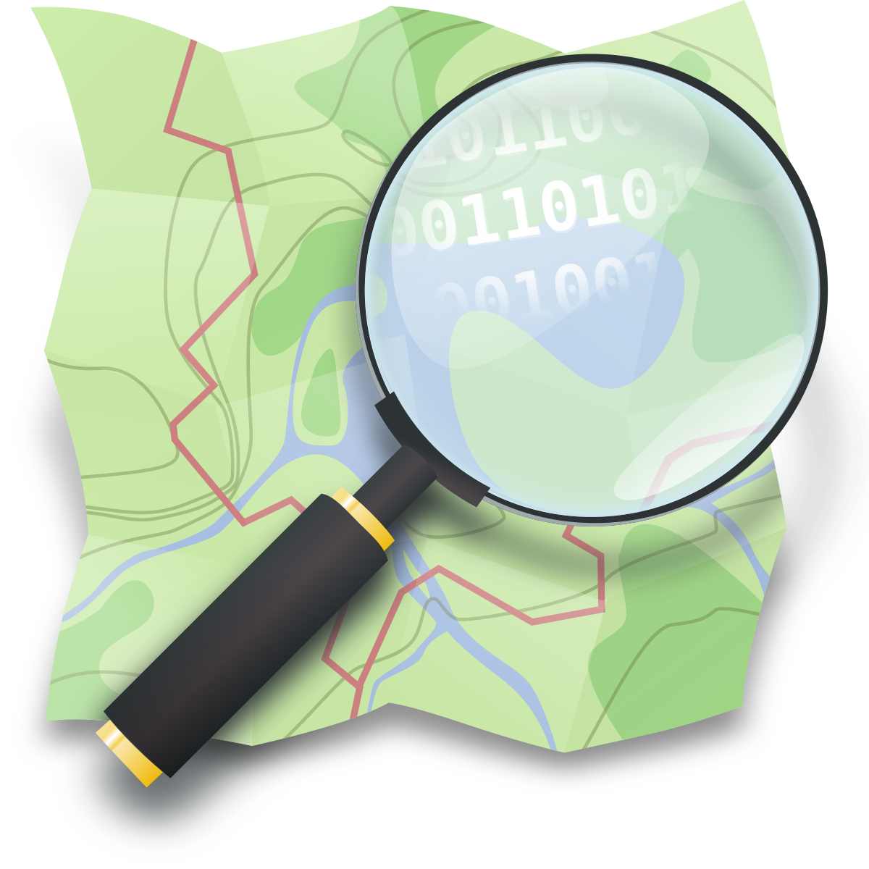
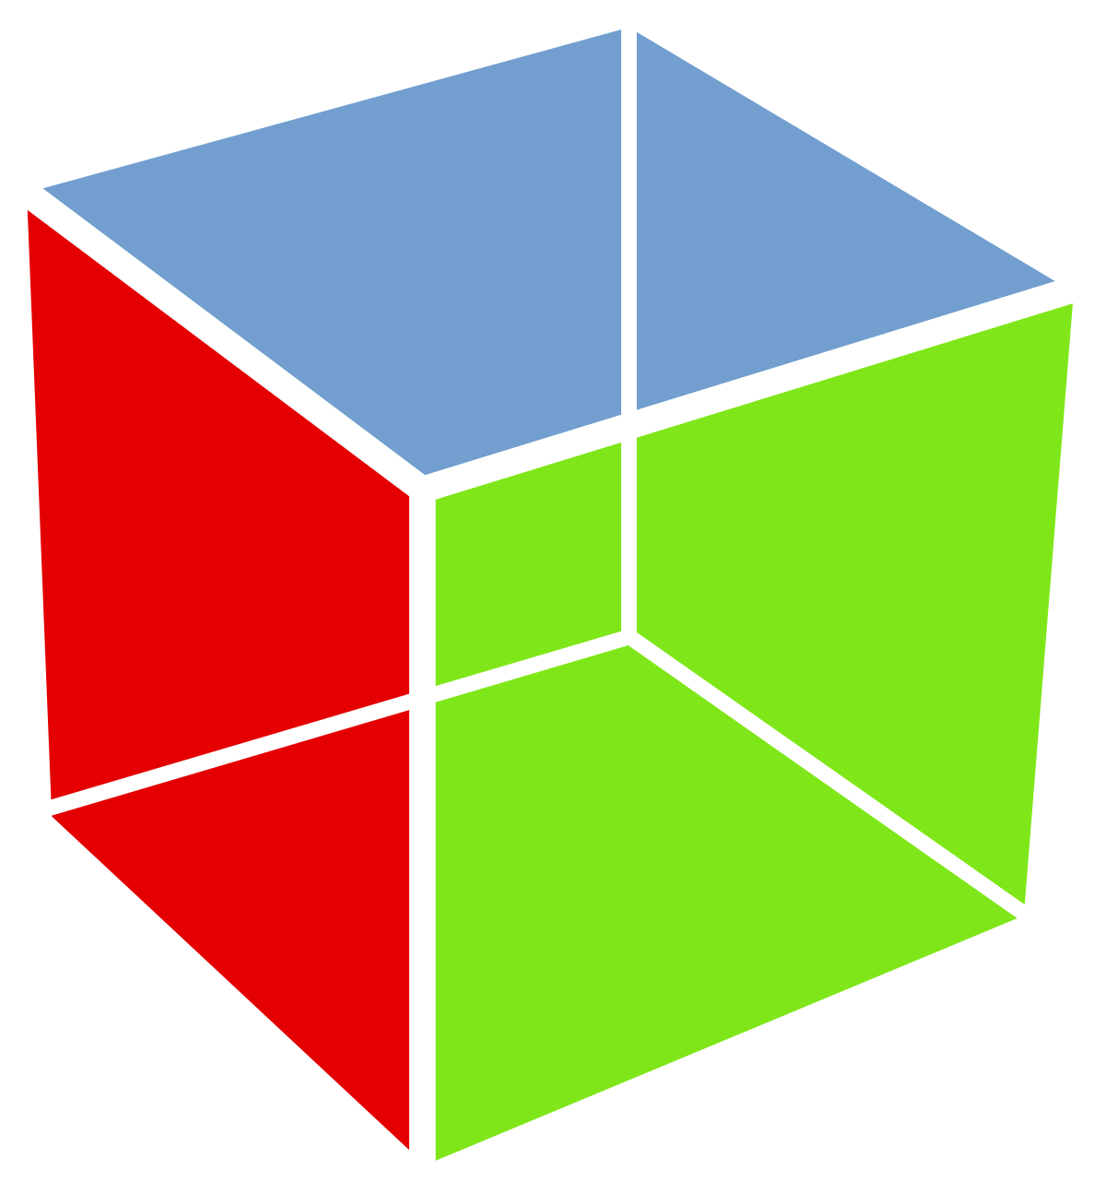

Baby Steps
Need to build program from scratch!
32
Notes:
As of now, our program, whose sole purpose was to satisfy the rubrics, has a long way to go to become even remotely desirable for students. However, we have some ideas about where to start.
Since our current program is not completely our own, we will be learning to use other open street map apis as well as gtk. We will also be learning to develop applications using each platforms respective tools, such as Xcode and android studio, and how to transfer progress between platforms. As fledging developers, a great deal of learning and researching will be expected.

Slide 33
Simply Map
Our map has:
Usable interface and functions
Effective Algorithms for shortest path and salesman’s problem
But still there are rooms for improvement.
We hope that our map could become a part of UofT students’ lives.
33
Notes:
Summary:
Usable interface and basic functions
Effective Algorithm for shortest path and salesman’s problem
But still room for improvement
Hope that our map could become a part of UofT students’ lives.

Slide 34

On your way of pursuing your dream, wherever you are lost, our map can guide you to the place you want.
34

Slide 35
References:
[1] “What is annealing? heat treatment process for annealing,” Win Win Solution, 09-Feb-2021. [Online]. Available: https://www.win-therm.com.my/what-is-annealing-heat-treatment-process-annealing/. [Accessed: 30-Apr-2022].
[2] “2-opt,” Wikipedia, 25-Jul-2021. [Online]. Available: https://en.wikipedia.org/wiki/2-opt#/media/File:2-opt_wiki.svg. [Accessed: 30-Apr-2022].
[3] Toronto Pearson Airport. Toronto [Online]. Available: https://www.torontopearson.com/en
[4] Young woman traveler looking map and walking in the nature education area. kitzstocker [Online]. Available: https://elements.envato.com/young-woman-traveler-looking-map-and-walking-in-th-PJPGKQS. [Accessed: 30-Apr-2022]
[5] C. Shortsleeve, “How to meditate on a plane (everyone's doing it),” Condé Nast Traveler, 27-Oct-2016. [Online]. Available: https://www.cntraveler.com/story/why-you-should-meditate-on-a-plane-and-how-to-do-it. [Accessed: 30-Apr-2022].
[6] 职场智谋.css-1cd9gw4{margin-left:.3em;}研究人性的规律与智慧，揭秘职场潜规则以及办公室政治, “老板为了稳住员工，就会使用画饼的手段，如何分辨画饼还是器重？,” 知乎专栏. [Online]. Available: https://zhuanlan.zhihu.com/p/148816318. [Accessed: 30-Apr-2022].
[7] “Seven transformational things that happened at U of T over the past decade,” University of Toronto News. [Online]. Available: https://www.utoronto.ca/news/seven-transformational-things-happened-u-t-over-past-decade. [Accessed: 30-Apr-2022].
[8] “File:forbidden symbol transparent.svg,” Wikimedia Commons. [Online]. Available: https://commons.wikimedia.org/wiki/File:Forbidden_Symbol_Transparent.svg. [Accessed: 30-Apr-2022].
35

Slide 36
References:
[9] “File:windows logo - 2021.SVG,” Wikimedia Commons. [Online]. Available: https://commons.wikimedia.org/wiki/File:Windows_logo_-_2021.svg. [Accessed: 30-Apr-2022].
[10] The GTK Team, “The GTK project - a free and open-source cross-platform Widget Toolkit,” The GTK Team. [Online]. Available: https://www.gtk.org/. [Accessed: 30-Apr-2022].
[11] “Android Studio 4.0,” Android Developers Blog, 28-May-2020. [Online]. Available: https://android-developers.googleblog.com/2020/05/android-studio-4.html. [Accessed: 30-Apr-2022].
36

